Slide 1
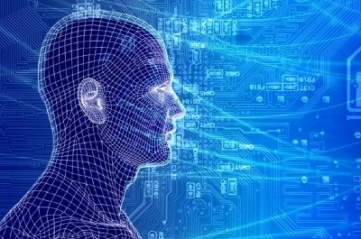
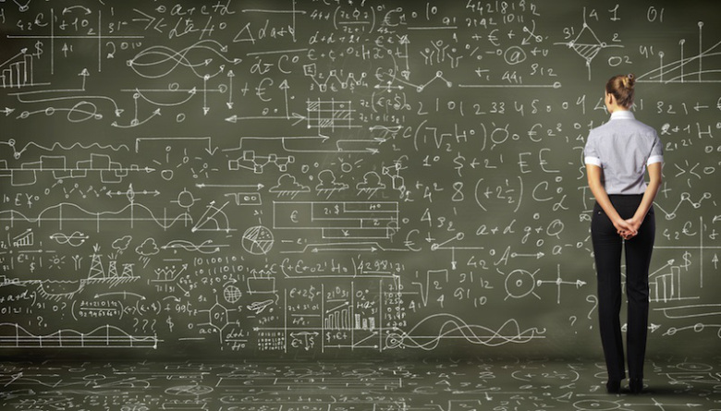
Introduction To Machine Learning Selected Topics
David Meyer
Brocade Chief Scientist and Fellow
dmm@{brocade.com,uoregon.edu,1-4-5.net,..}
http://www.1-4-5.net/~dmm/ml/talks/2016/ml_intro.20160921.{pptx,pdf}
ML Talk with Ruckus
21 Sep 2016

Slide 2
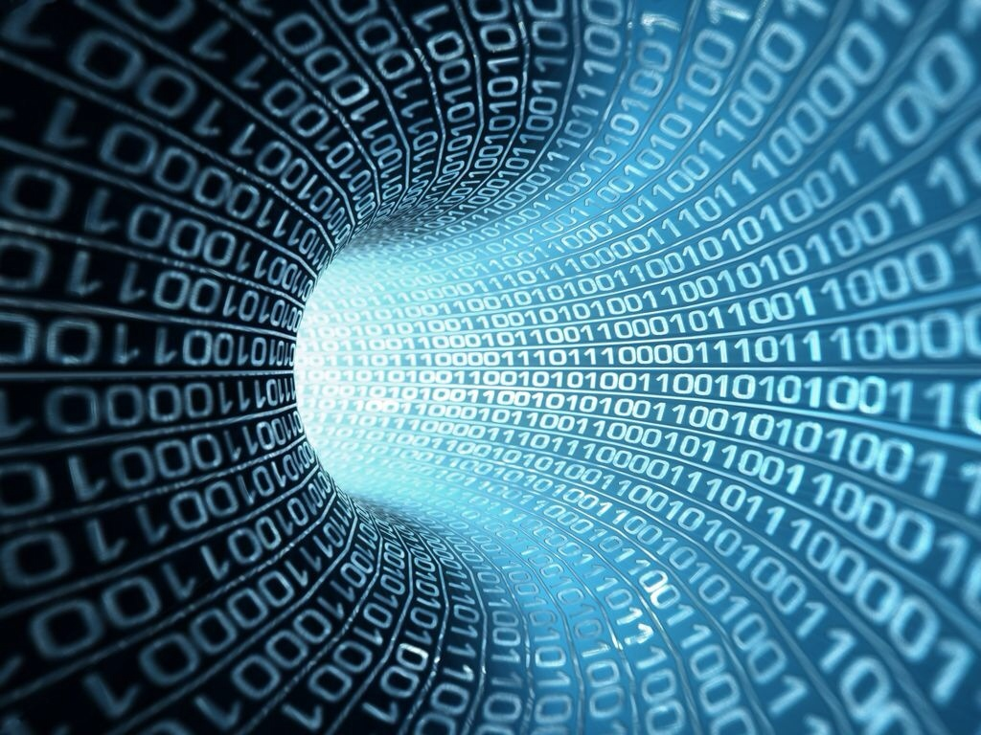
You might be surprised but what is going to drive innovation in the enterprise and in the public cloud is machine learning.
Bill Coughran, Sequoia Capital #‎ONUGSpring16‬

Slide 3
Machine Learning is the way we are going to automate your automation.
Chris Wright, RedHat CTO #RHSummit

Slide 4
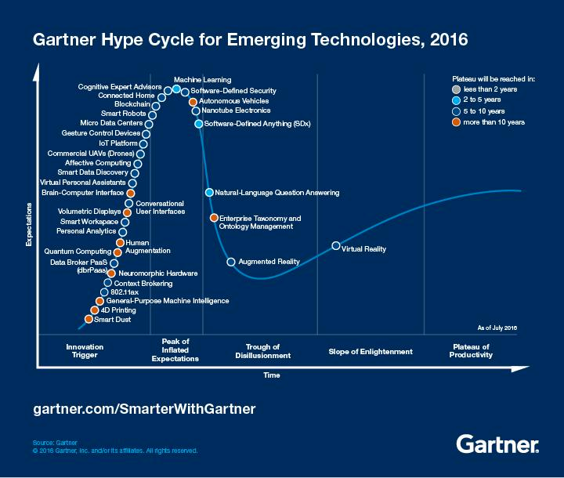
However…
You are here (again)

Slide 5
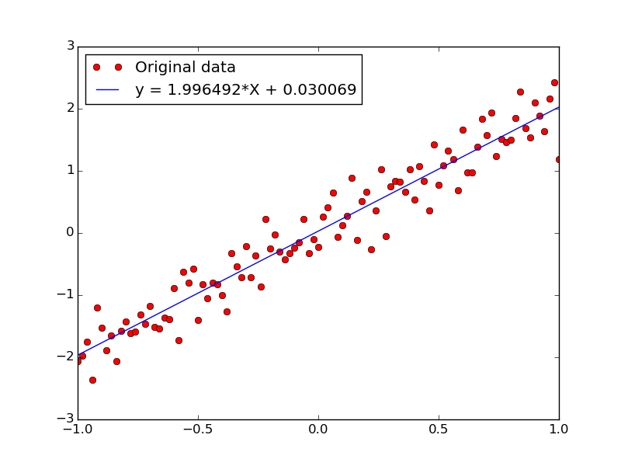
Agenda
Who Am I?
Probability Theory Review?
What Is Machine Learning?
What is all the (Machine Learning) Excitement About?
Integrated Approaches
Histograms, LDA, and Neural Networks
Machine Learning Excitement Redux: Beyond Static Learning
Technical explanations/code
https://github.com/davidmeyer/ml
http://www.1-4-5.net/~dmm/ml

Slide 6
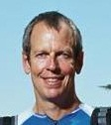
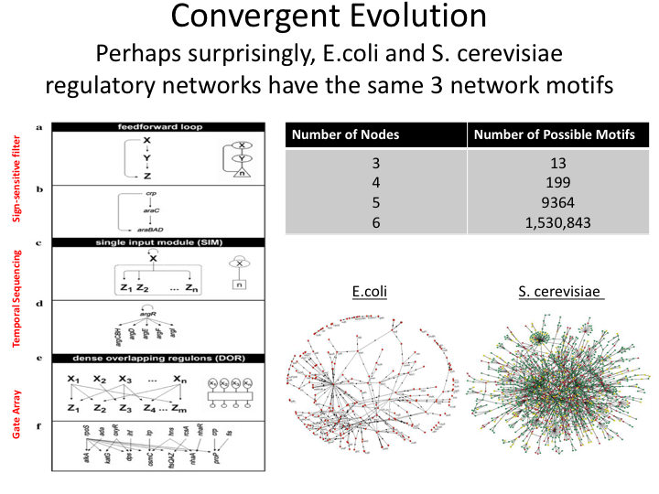
Who Am I?
Chief Scientist and Fellow at Brocade
Adjunct Faculty Computer Science University of Oregon
http://www.routeviews.org/
15 years at Cisco
5 years at Sprint
4 years at Brocade
IETF, NANOG, RIPE, OpenDaylight, ...
Other areas I’ve been active in: Biology, Math, Control Theory, Law, ...
Focus of last several years: Machine Learning theory and practice for networking
See http://www.1-4-5.net/~dmm/vita.html for more detail

Slide 7
Gain/Sensitivity Tradeoff In Feedback Control
Bode Sensitivity Integral
Low
Tradeoff ≈ Law
Gain
Feasible Frontier
Impossible
ideal
High
Precise
Sloppy
Precision

Slide 9
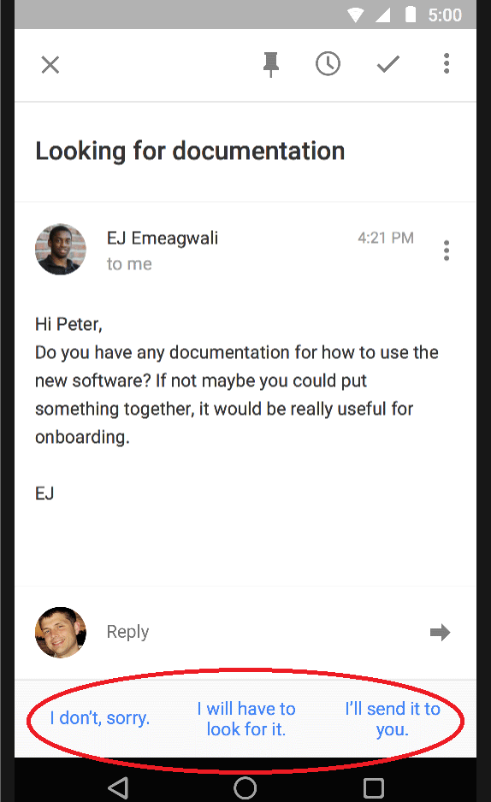
Aside: A Couple of Aspects Of Our Challenge
The current distance between theory and practice in Machine Learning is effectively zero
What does this mean?
Consider “sequence to sequence learning”
https://arxiv.org/pdf/1409.3215v3.pdf
Plus “thought vectors”
Elapsed time from NIPS paper to Google Smart Reply¹?
A little over one year
This means that the latest theory is being rapidly deployed in product
The best ML theory folks are also the ML best coders
And the field is moving at an astounding rate
e.g., https://github.com/LeavesBreathe/tensorflow_with_latest_papers
Which not surprisingly means that achieving SOA ML results requires deep understanding of both theory and practice
This presents a challenge (skills mismatch) for the networking field
1 https://gmail.googleblog.com/2016/03/smart-reply-comes-to-inbox-by-gmail-on-the-web.html

Slide 10
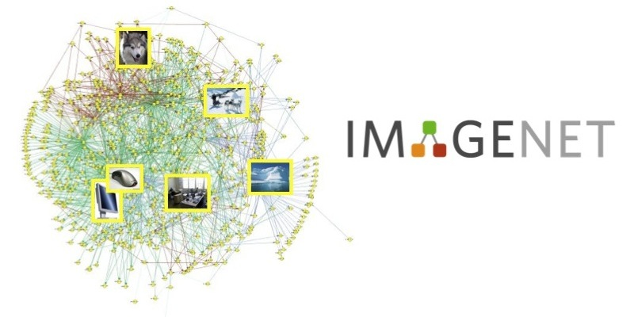
Another Aspect Of Our Challenge
What is our ”ImageNet”?
And is there a theory of “network”, or is every network a one-off?

Slide 11
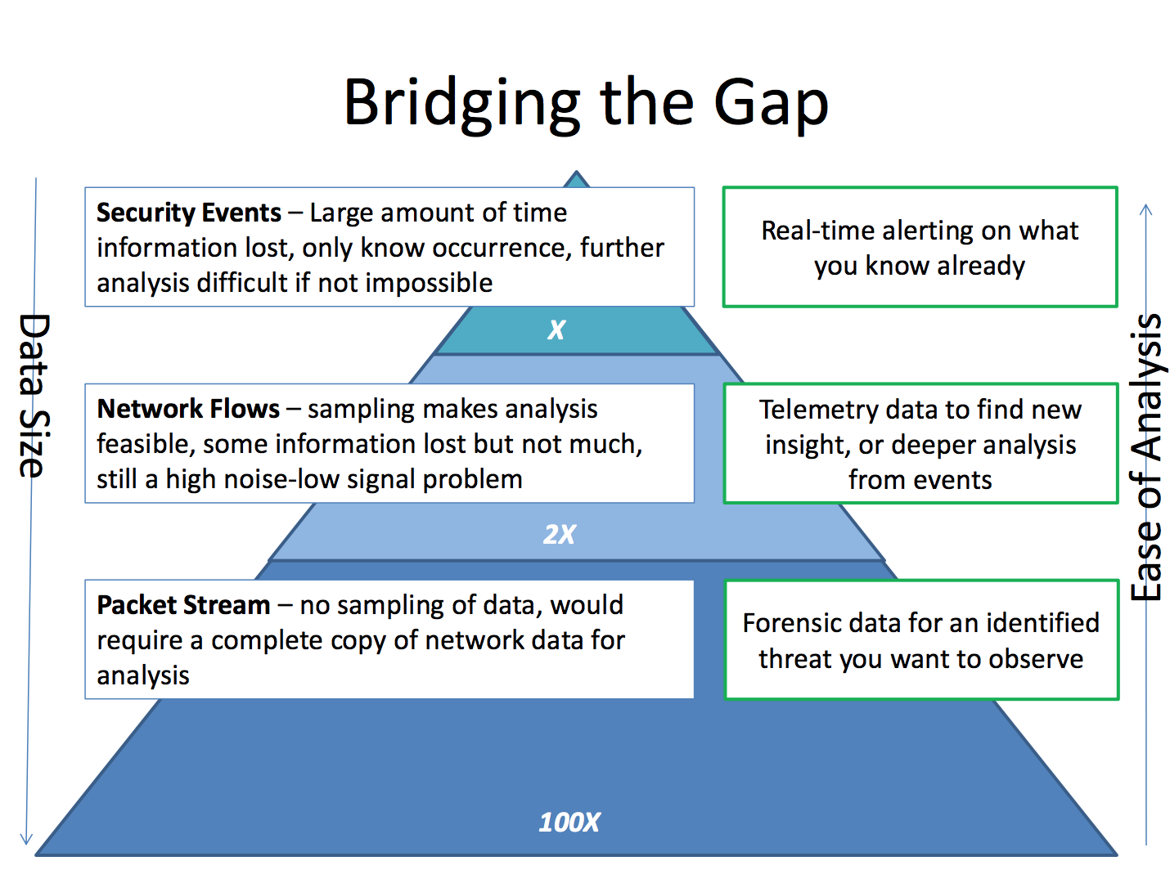

Slide 12
Agenda
Who Am I?
Level Set: What Is Machine Learning?
What is all the (Machine Learning) Excitement About?
Integrated Approaches
Histograms, LDA, and Neural Networks
Machine Learning Excitement Redux: Beyond Static Learning
Technical explanations/code
https://github.com/davidmeyer/ml
http://www.1-4-5.net/~dmm/ml

Slide 13
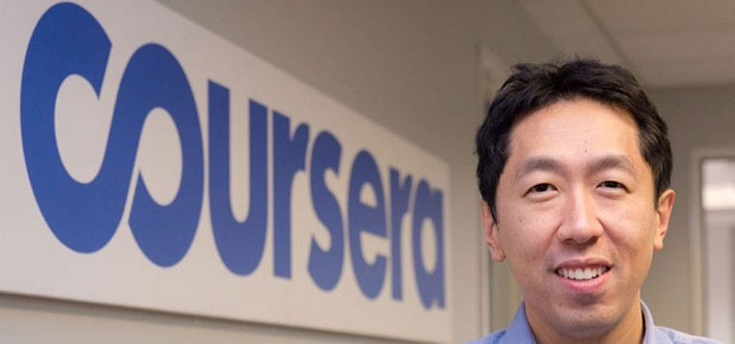
First, What is Machine Learning?
The complexity in traditional computer programming is in the code (programs that people write). In machine learning, learning algorithms are in principle simple and the complexity (structure) is in the data. Is there a way that we can automatically learn that structure? That is what is at the heart of machine learning.
-- Andrew Ng
Said another way, we want to discover the Data Generating Distribution that underlies the data that we observe. This is the function that we want to learn.
Moreover, we care about primarily about the generalization accuracy of our model (function)
Accuracy on examples we have not yet seen (BTW, how is this possible?)
as opposed the accuracy on the training set (note: overfitting)

Slide 14
Same Thing Said In Cartoon Form
Traditional Programming
Data
Computer
Output
Program
Machine Learning
Data
Computer
Program
Environment
Output
Supervised Learning: training set of the form {(x_{i},y_{i})}; y_{i} = f(x_{i})
Reinforcement Learning: Learn from interaction with environment
Unsupervised Learning: training set of the form {x_{i}}

Slide 15
So When Would We Use Machine Learning?
When patterns exists in our data
Even if we don’t know what they are
Or perhaps especially when we don’t know what they are
We can not pin down the functional relationships mathematically
Else we would just code up the algorithm
When we have lots of (unlabeled) data
Labeled training sets harder to come by
Data is of high-dimension
High dimension “features”
For example, sensor data
Want to “discover” lower-dimension representations
Dimension reduction
Aside: Machine Learning is heavily focused on implementability
Frequently using well know numerical optimization techniques
Lots of open source code available
All kinds of open source frame works, e.g., https://www.tensorflow.org/ or http://torch.ch/
Well-worn libraries http://scikit-learn.org/stable/ (many others)
Languages (e.g., octave: https://www.gnu.org/software/octave/)

Slide 16
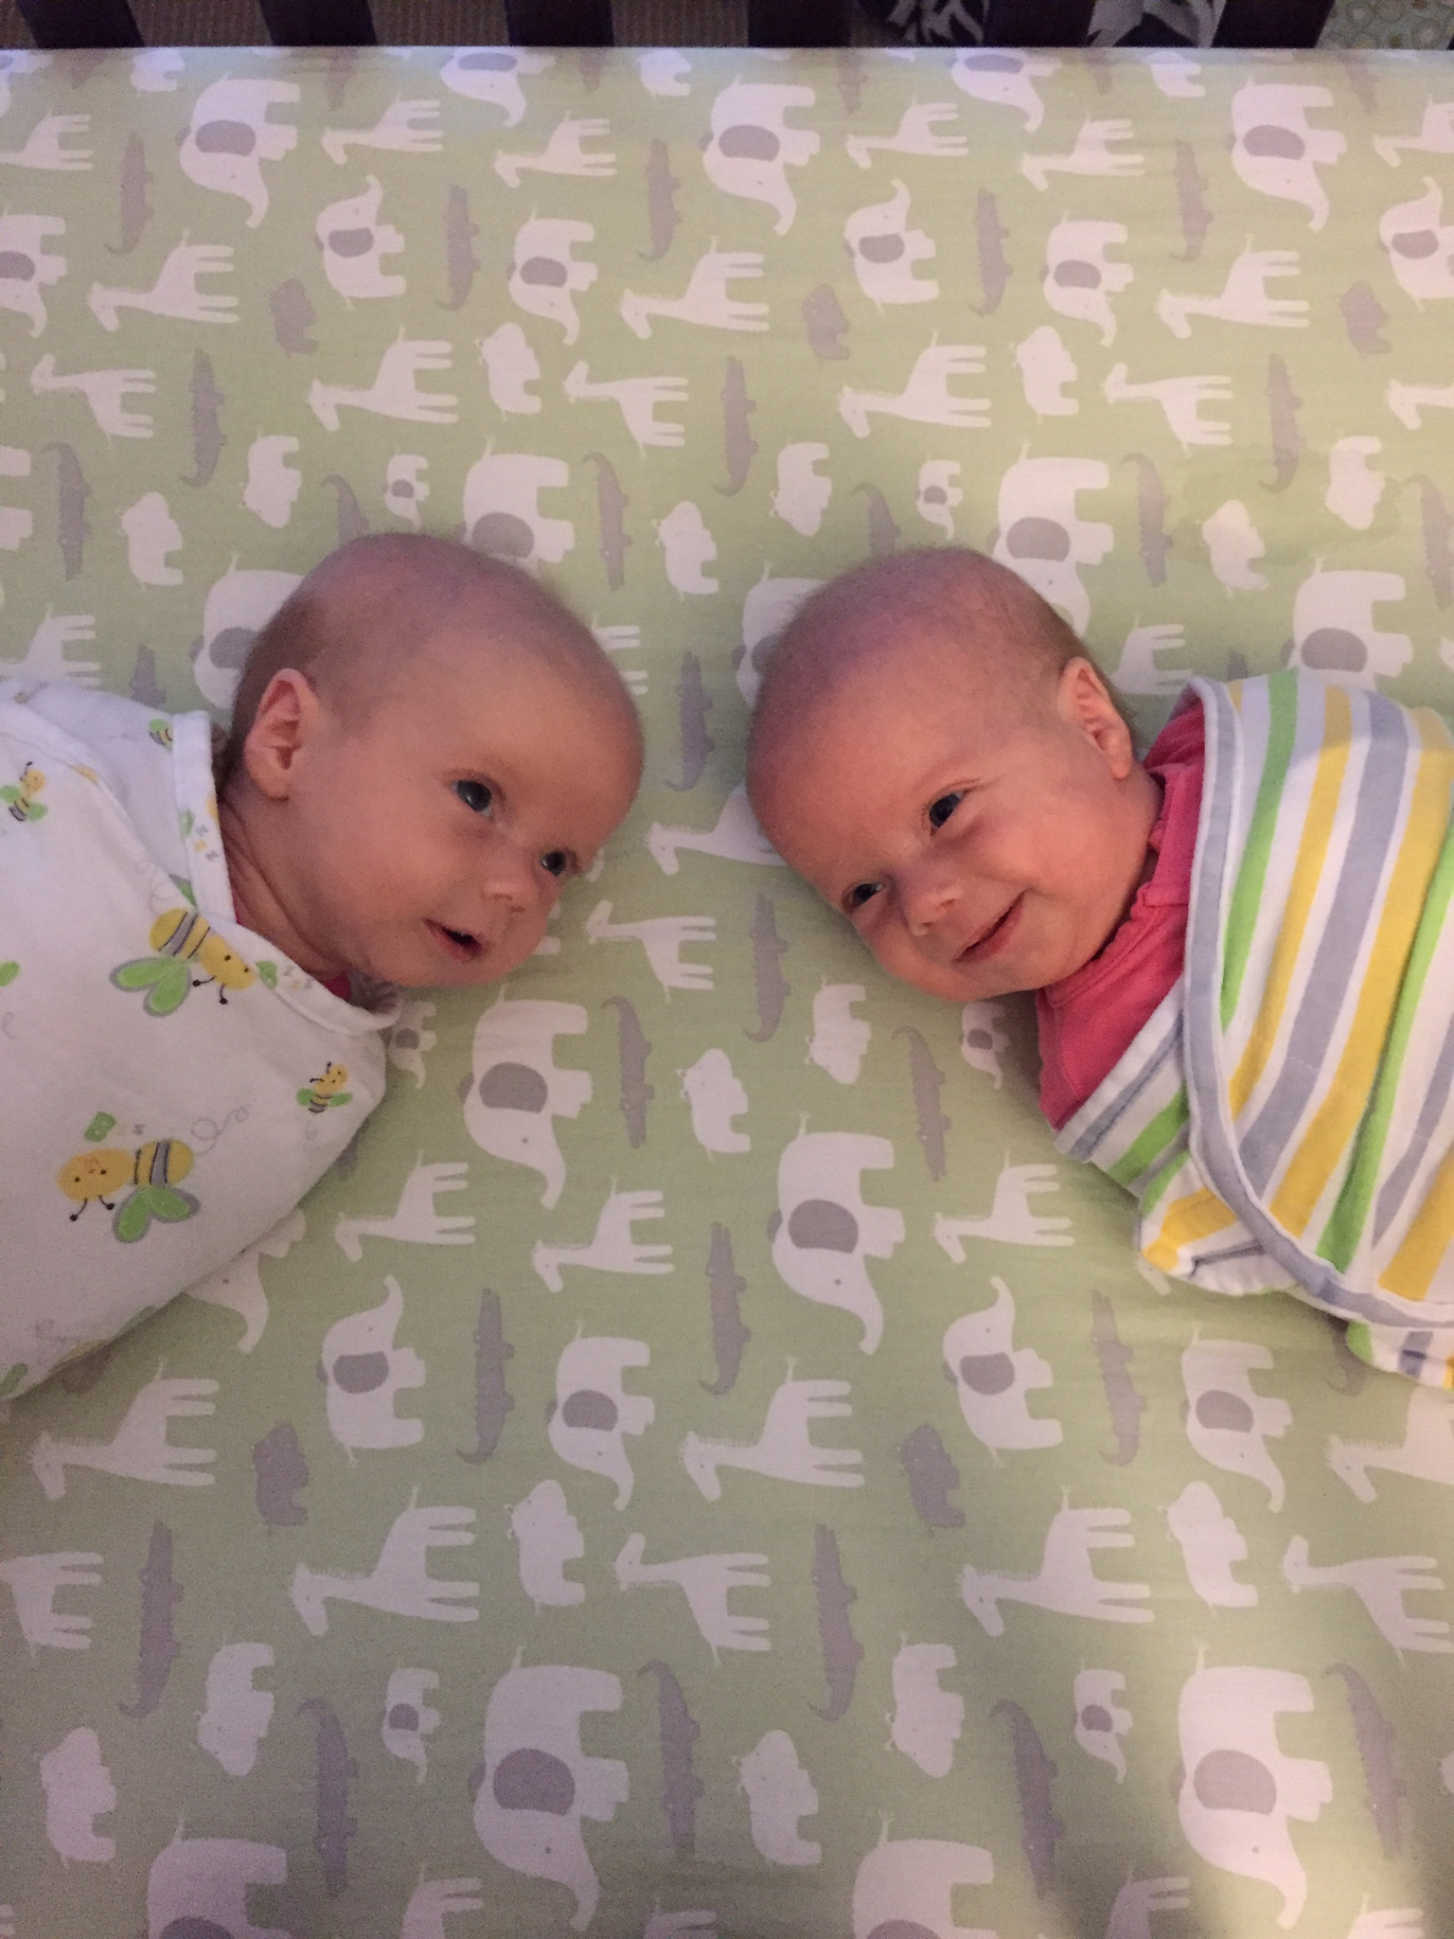
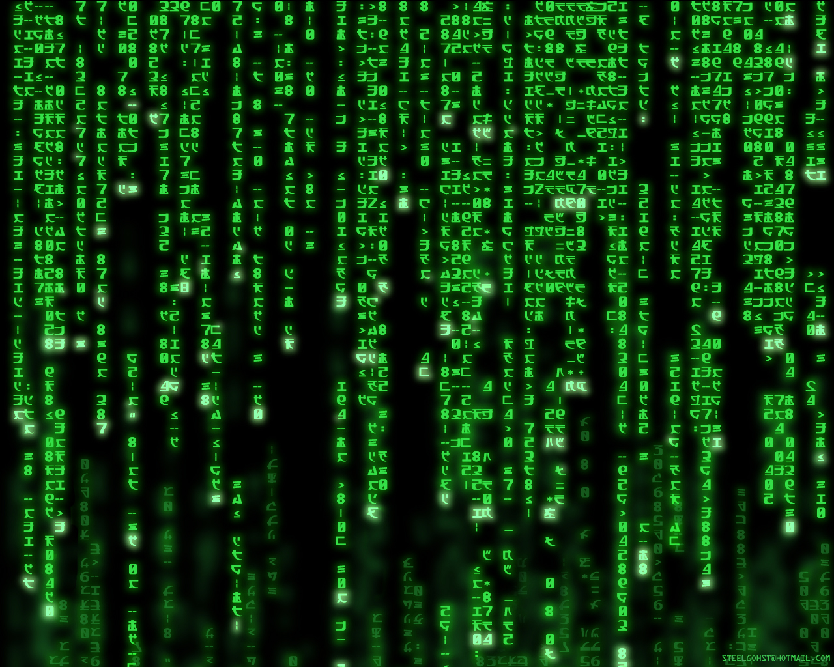
Why Machine Learning is Hard?
Your ML Algorithm Sees
A Bunch of Bits
You See

Slide 17
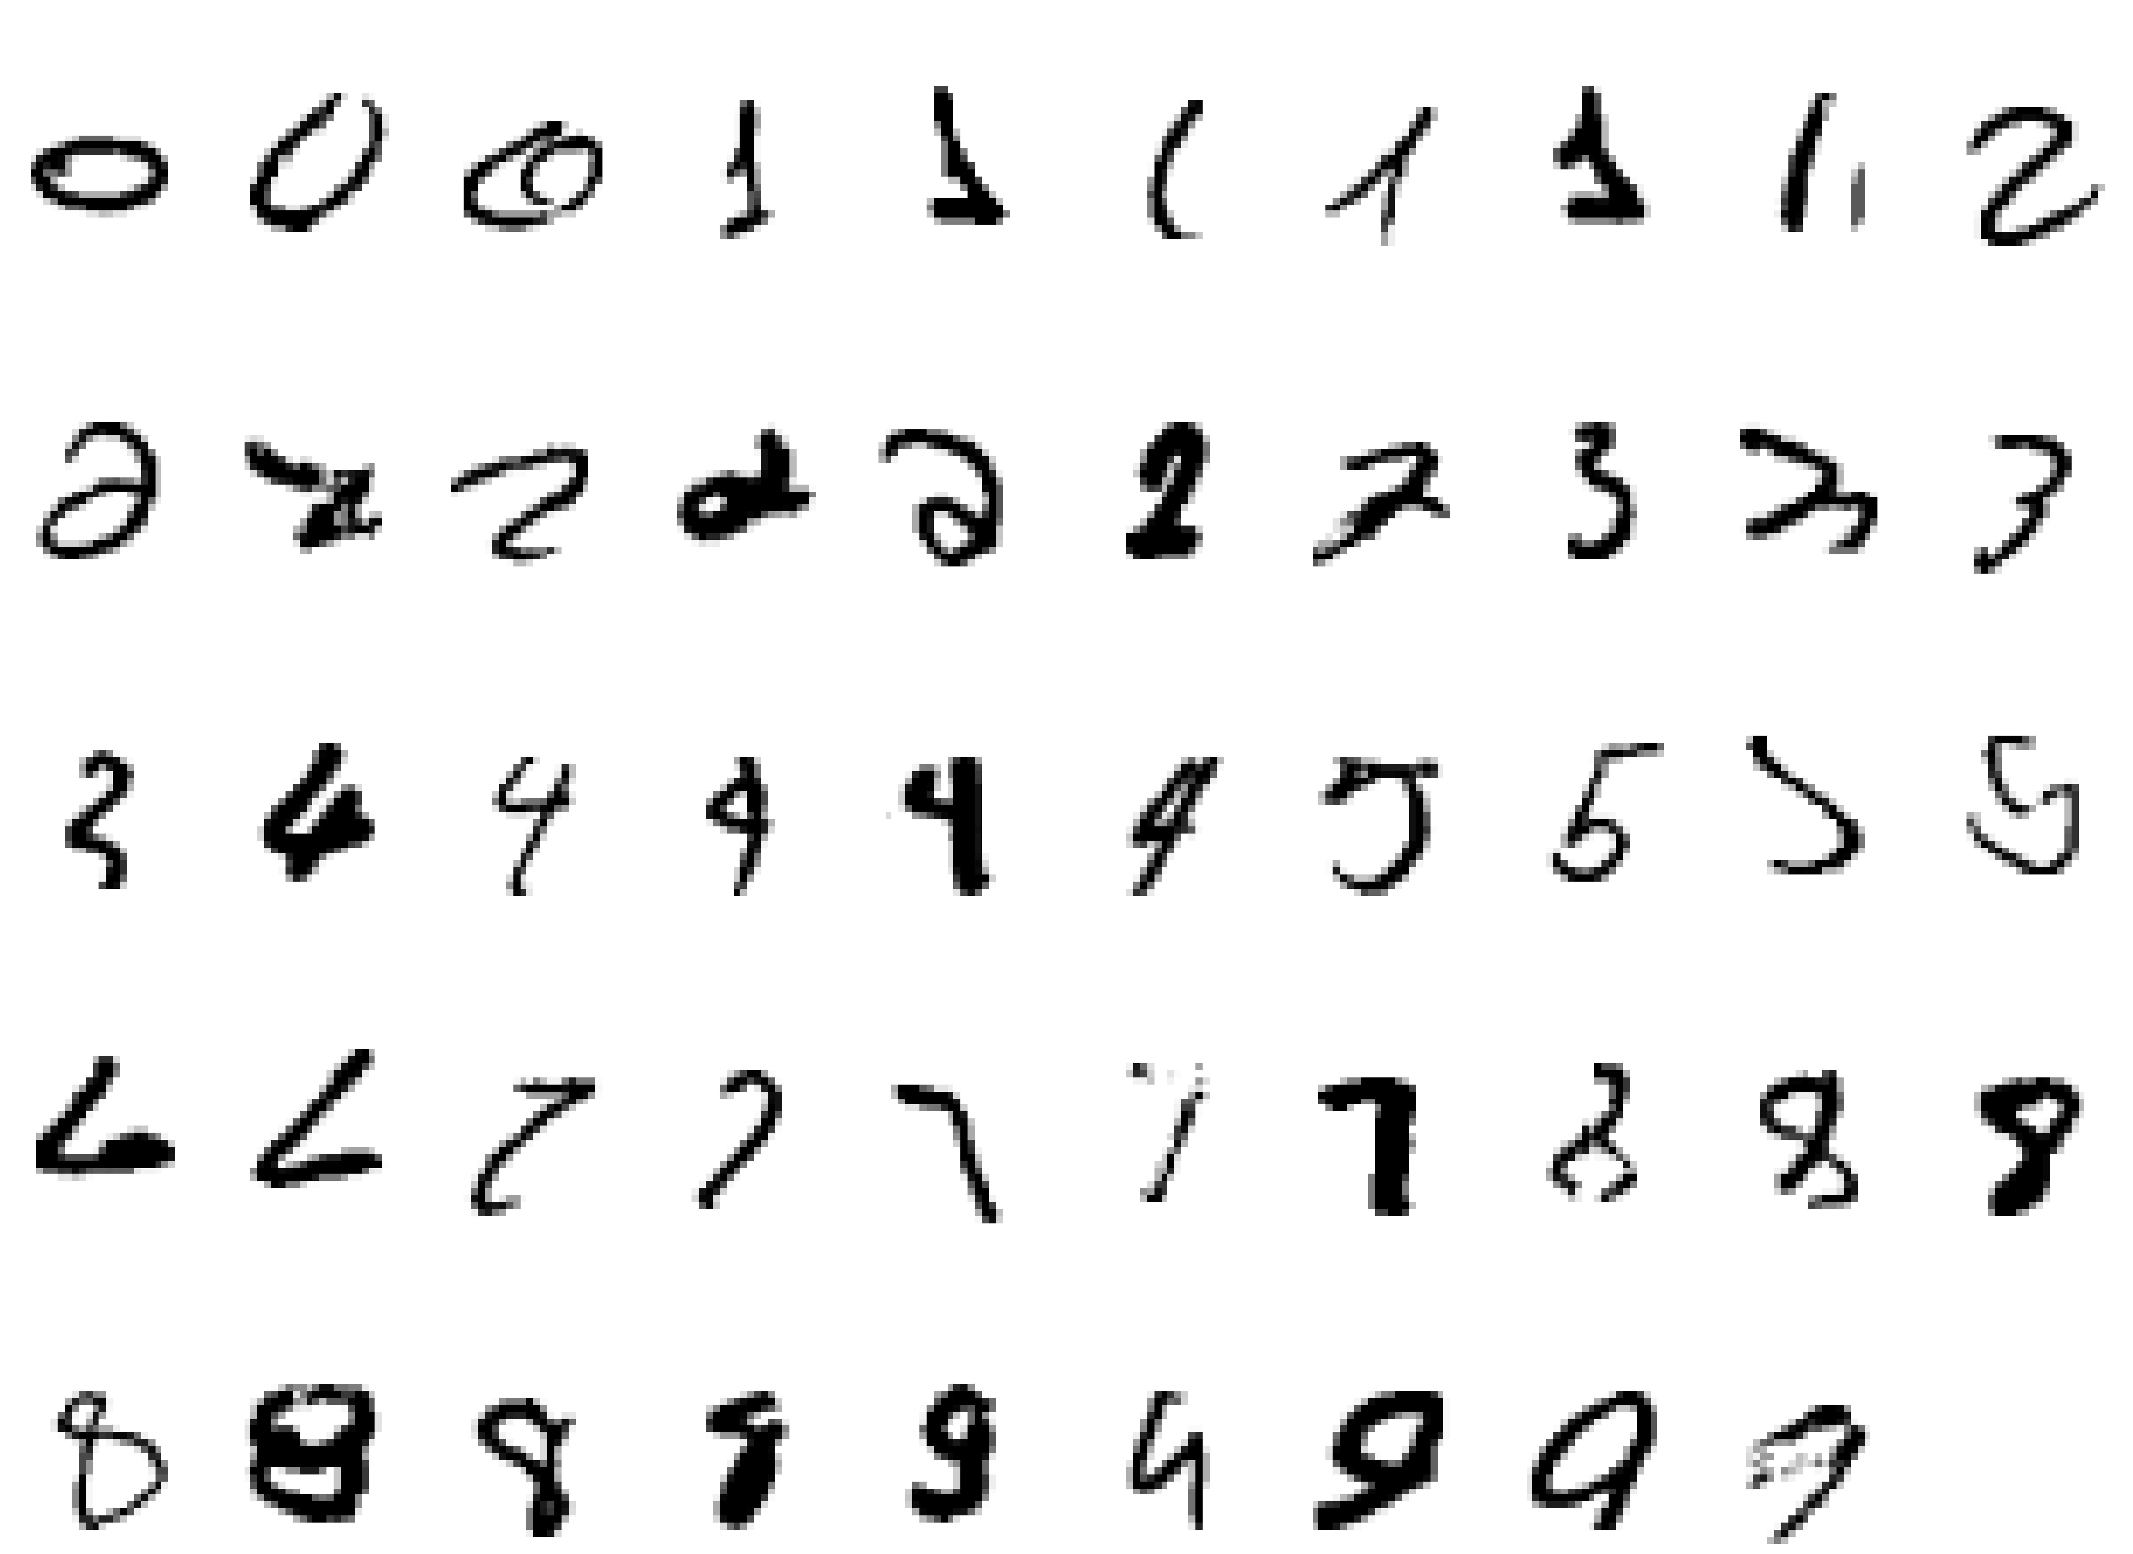
Why Machine Learning Is Hard, Redux What is a “2”?

Slide 18
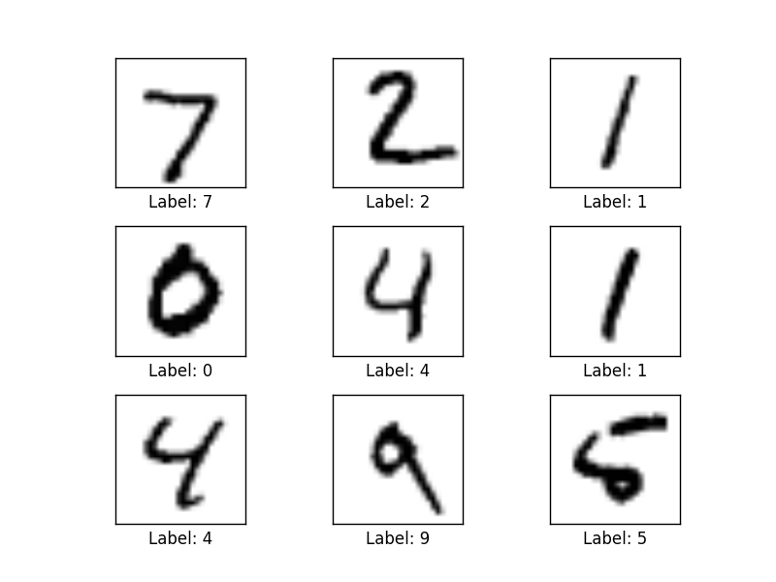
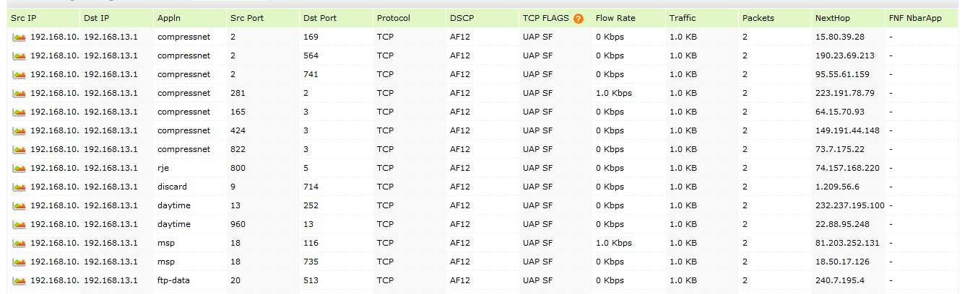
BTW, How Hard Is It These Days To Write Code That Recognizes Handwritten Digits?
MNIST: 28x28 Grayscale Handwritten Digit Dataset
Training set: 55000 images
Test set: 10000 images
Validation set: 5000 images
Features here are pixels (28x28 = 784)
Can We Analyze Network Flow (or other) Data In A Similar Fashion?
Features here are
various counters

Slide 19
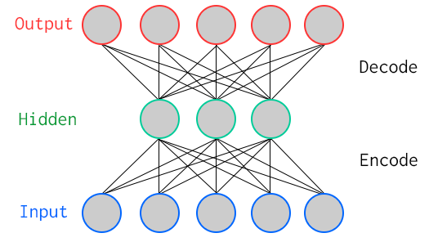
One Way To Learn To Recognize MNIST: Use An Autoencoder Special Kind of Neural Network
784
Artificial Neurons
100
Artificial Neurons
784
Key Characteristic: Hidden layer has fewer units than input/output → Compression
Goal: Minimize reconstruction (decode) error
How to define error (loss, cost)?
Binary classification: Threshold reconstruction error → normal/abnormal
Unsupervised learning

Slide 20

Another Way To Look At This Minimizing Reconstruction Error During Training
We can use autoencoders do anomaly detection by bounding reconstruction error.
That is, if an new example has reconstruction error greater than some hyper-parameter,
we declare a potential anomaly. Importantly AEs can capture the covariance between
features, but have many of the classic AD challenges such as needing baselines, etc.

Slide 21
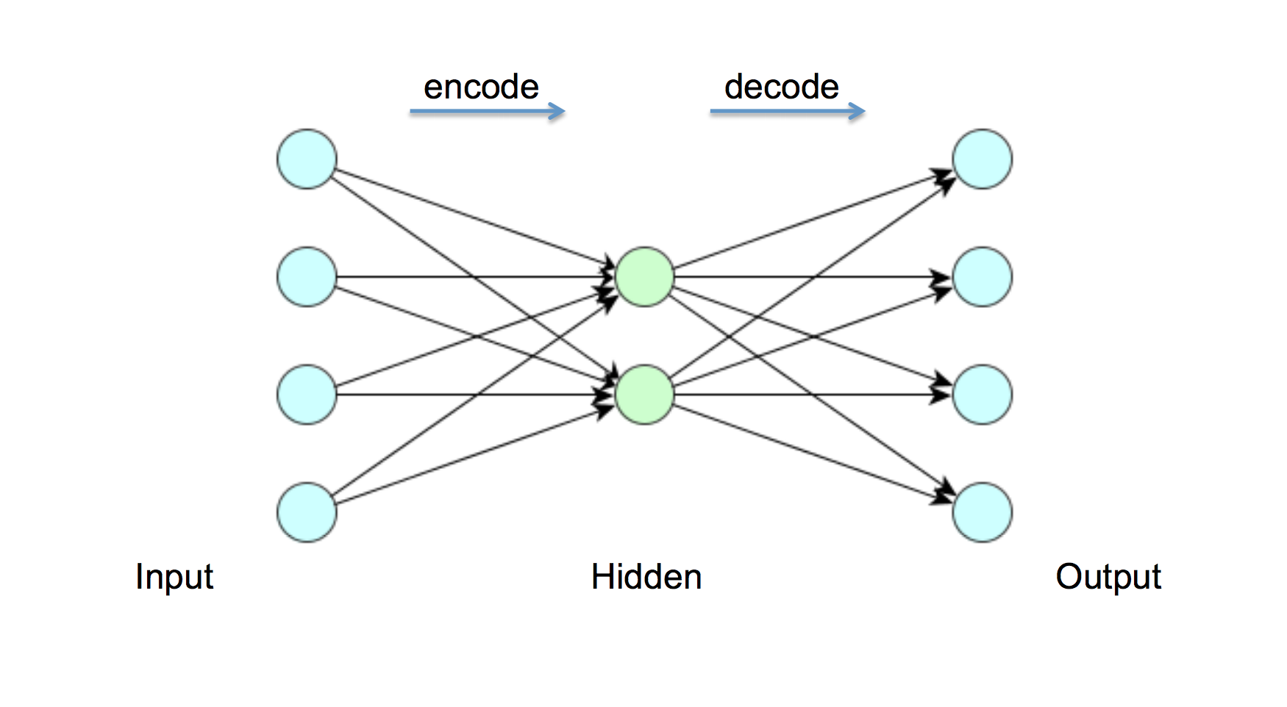
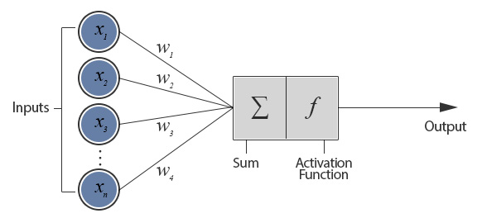
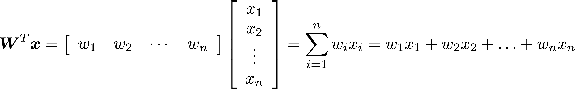
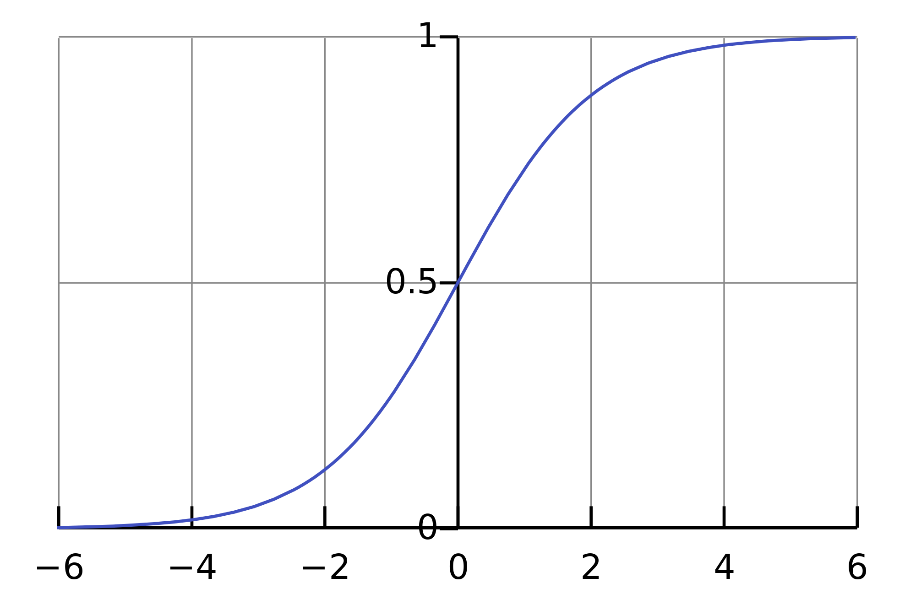
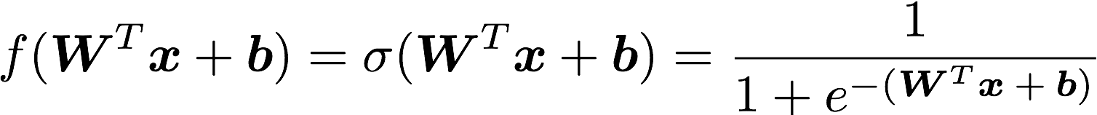
But First: What Does A Single Neuron Do?
Dot Product
784
100
784
BTW, how many parameters?
784x100 + 100x784 = 156800

Slide 22
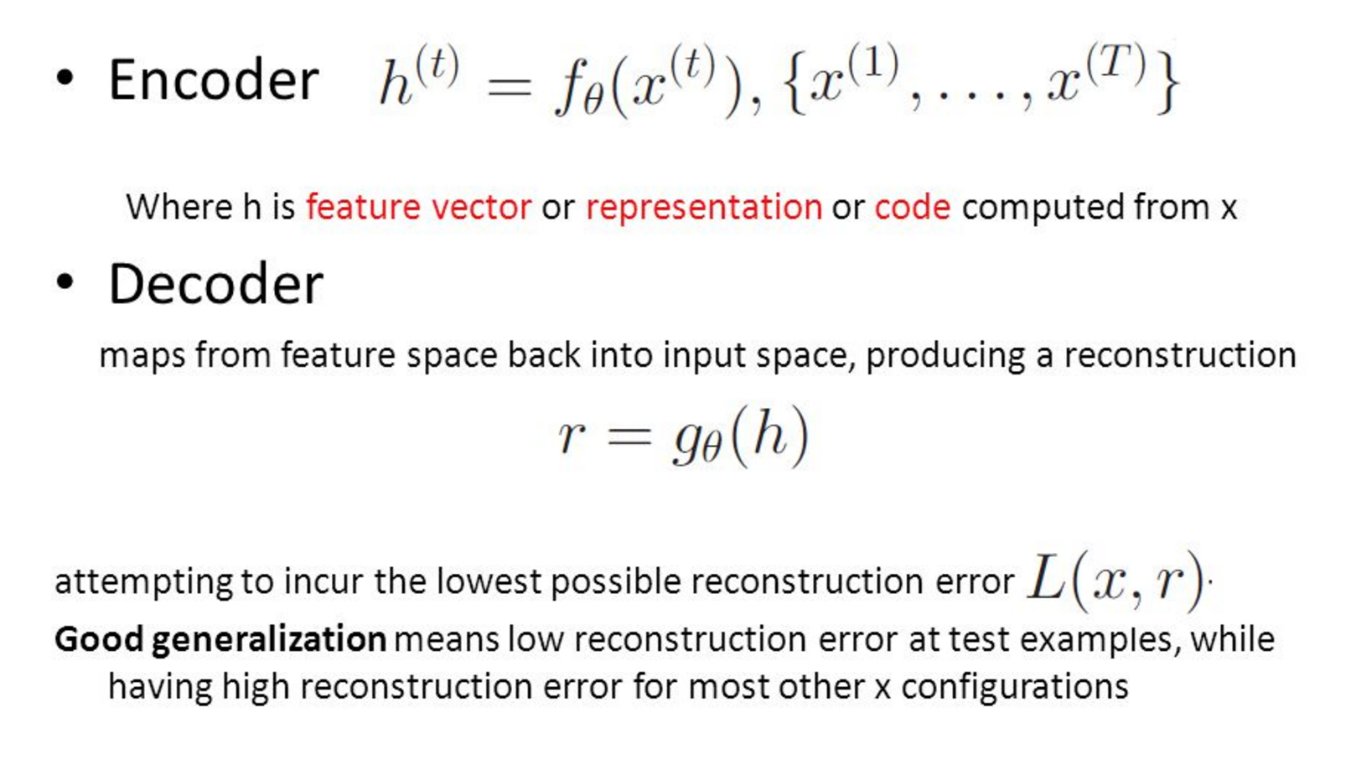
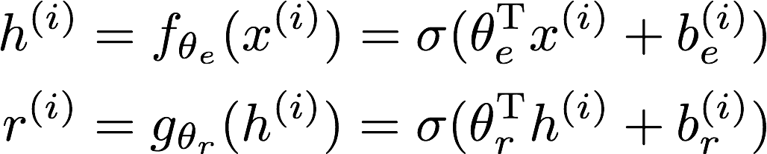
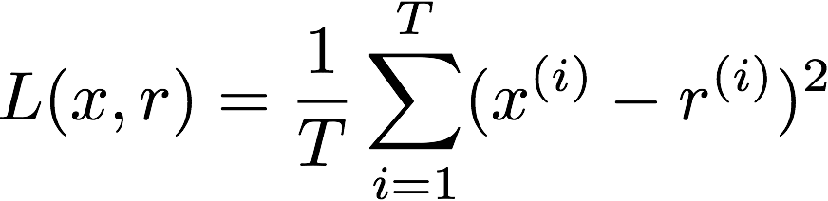
All Cool, But How Does The Autoencoder Actually Work?

Slide 23
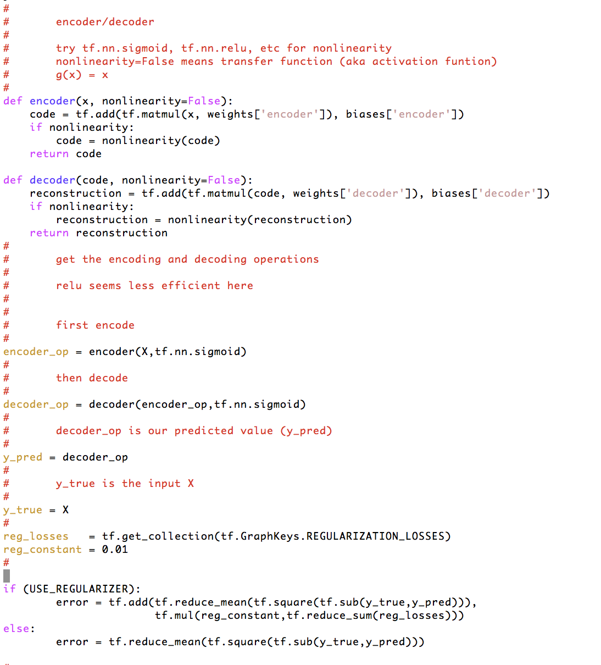
How Hard To Code This Up In Tensorflow?
https://github.com/davidmeyer/ml/blob/master/tensorflow/autoencoder.py

Slide 24
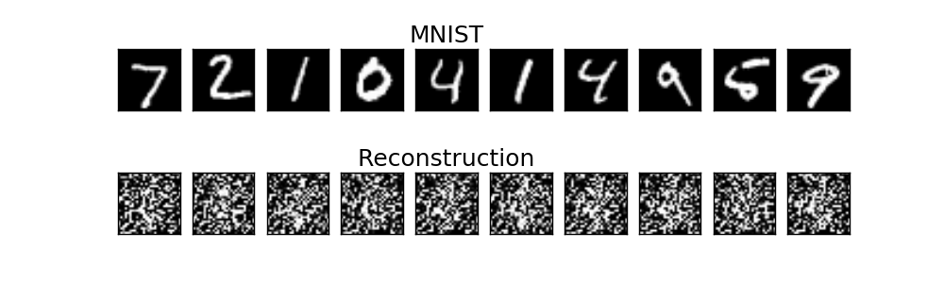
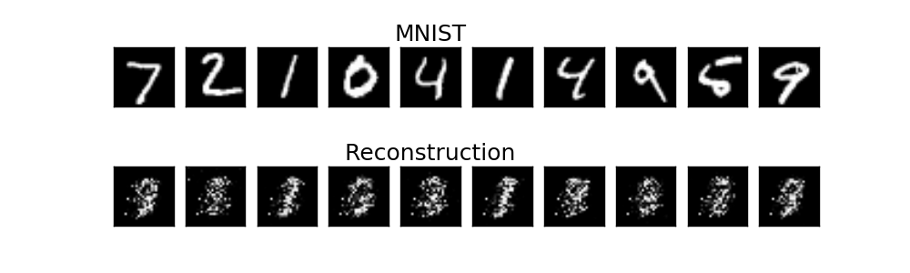
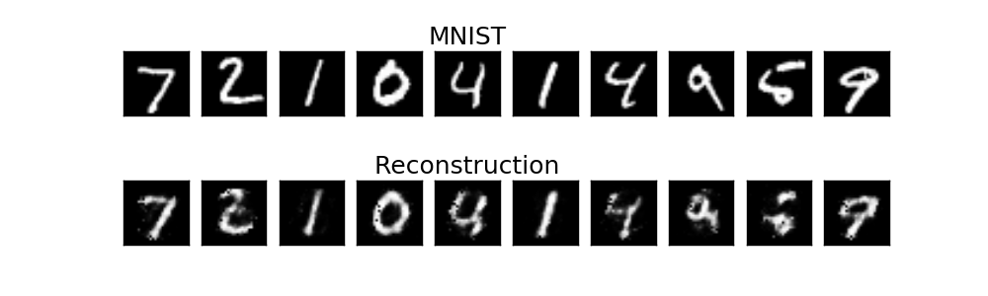
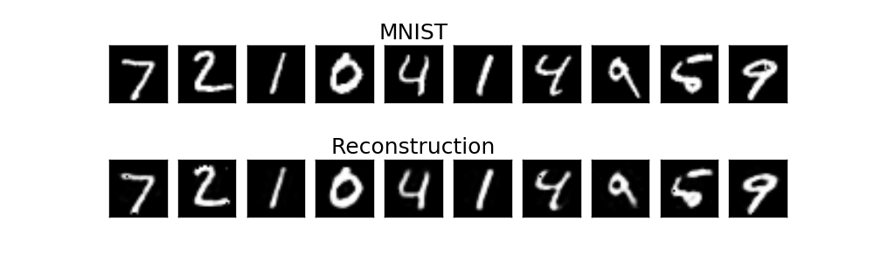
Autoencoder Output
1 example
10 examples
100 examples
1000 examples
After training, the AE gets low reconstruction error on digits from MNIST and high reconstruction error on everything else: It has learned to recognize MNIST

Slide 25
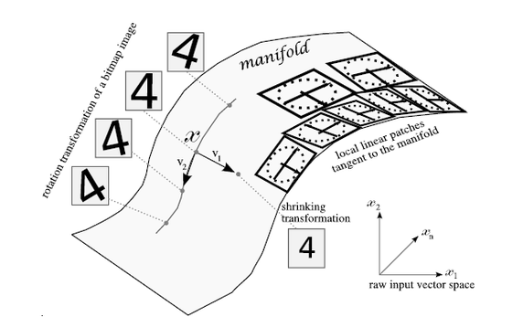
What Is Really Going On Here? (Manifold Hypothesis)
X is a high dimensional vector (28² = 784)
Data concentrated around a lower dimensional manifold
Hope to find representation R of that manifold
Graphic courtesy http://www.deeplearningbook.org

Slide 26
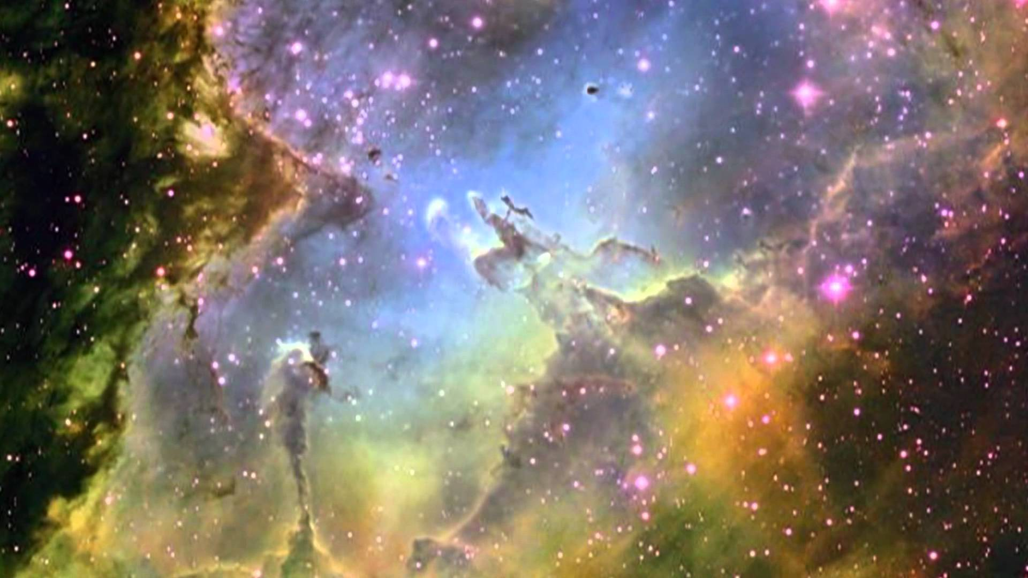
Many Beautiful Mysteries Remain
Back-propagation
Gradient-based optimization with gradients computed by back-prop
Why is such a simple algorithm so powerful?
Optimization an active area of research
Many new techniques , e.g., Layer Normalization
https://arxiv.org/pdf/1607.06450v1.pdf
Neural Nets
What are the units (artificial neurons) actually doing?
https://arxiv.org/pdf/1509.06321.pdf
Adversarial Images
Generative Adversarial Nets (GANs)
https://arxiv.org/abs/1412.6572
Why does deep and cheap learning work so well?
Physics perspective
http://arxiv.org/pdf/1608.08225v1.pdf
…
BTW, how many 28x28 grayscale images are there?
Say there are 8 bits of grayscale → 256⁷⁸⁴ possible images
How can such a simple autoencoder recognize them?

Slide 27
So What Kind of Problems Can We Solve With Machine Learning?
Pattern Recognition
Facial identities or facial expressions
Handwritten or spoken words (e.g., Siri)
Medical images
Sensor Data/IoT
Network traffic and performance
Optimization
Many parameters have “hidden” relationships that can be the basis of optimization
Pattern Generation
Generating images or motion sequences
Anomaly Detection
Unusual patterns in the telemetry from physical and/or virtual plants (e.g., data centers)
Unusual sequences of credit card transactions
Unusual patterns of sensor data from a nuclear power plant
or unusual sound in your car engine or …
Prediction
Future stock prices or currency exchange rates
Network events
…

Slide 28
Note that ML is a form of Induction (Supervised Learning Setting)
Given examples of a function (x, f(x))
Don’t explicitly know f
Rather, trying to learn f from the data
Labeled training data set (i.e., the f(x)’s)
Training set will be noisy, e.g., (x, (f(x) + ε))
Notation: (x_{i}, f(x_{i})) denoted (x^{(i)},y^{(i)})
y^{(i)} sometimes called t_{i} (t for “target”)
Predict function f(x) for new examples x
Discrimination/Prediction (Regression): f(x) continuous
Classification: f(x) discrete
Estimation: f(x) = P(Y = c|x) for some class c

Slide 29
BTW, How Can Machine Learning Possibly Work?
We want to build statistical models that generalize to unseen cases
What assumptions do we need to do this (essentially predict the future)?
4 main “prior” assumptions are (at least) required
Smoothness
Manifold Hypothesis
Distributed Representation/Compositionality
Compositionality is useful to describe the world around us efficiently → distributed representations (features) are meaningful by themselves.
Non-distributed → # of distinguishable regions linear in # of parameters
Distributed → # of distinguishable regions grows almost exponentially in # of parameters
Each parameter influences many regions, not just local neighbors
Want to generalize non-locally to never-seen regions → essentially exponential gain
Shared Underlying Explanatory Factors
The assumption here is that there are shared underlying explanatory factors, in particular between p(x) (prior distribution) and p(Y|x) (posterior distribution). Disentangling these factors is in part what machine learning is about.
Before this, however: What is the problem in the first place?

Slide 30
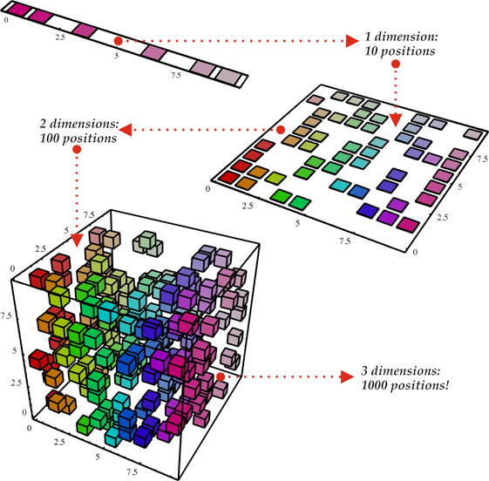
Why ML Is Hard The Curse Of Dimensionality
To generalize locally, you need representative examples from all relevant variations (and there are an exponential number of them)!
Classical Solution: Hope for a smooth enough target function, or make it smooth by handcrafting good features or kernels
Smooth?
(i). Space grows exponentially
(ii). Space is stretched, points
become equidistant

Slide 31
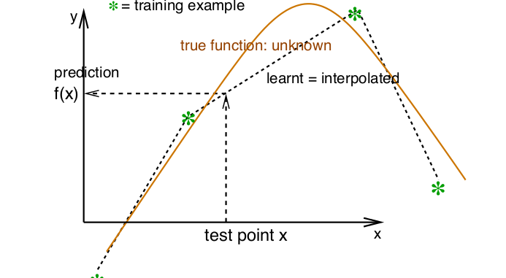
So What Is Smoothness?
Smoothness → If x is geometrically close to x’ then f(x) ≈ f(x’)

Slide 32
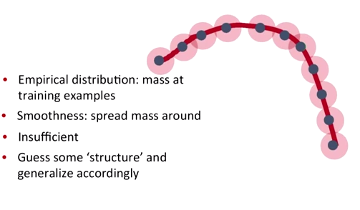
Smoothness, basically…
Probability mass P(Y=c|X;θ)
This is where the Manifold Hypothesis comes in…

Slide 33
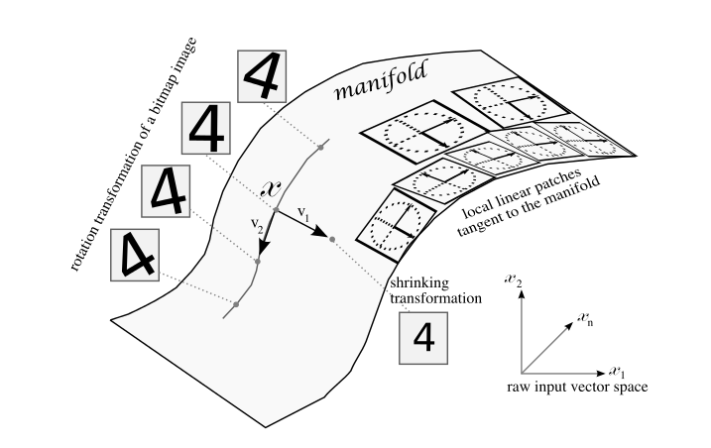
Manifold Hypothesis
The Manifold Hypothesis states that natural data forms lower dimensional manifolds
in its embedding space. Why should this be? Well, it seems that there are both
theoretical and experimental reasons to suspect that the Manifold Hypothesis is true.
So if you believe that the MH is true, then the task of a machine learning classification
algorithm is fundamentally to separate a bunch of tangled up manifolds.
However, consider Adversarial Images/Generative Adversarial Networks

Slide 34
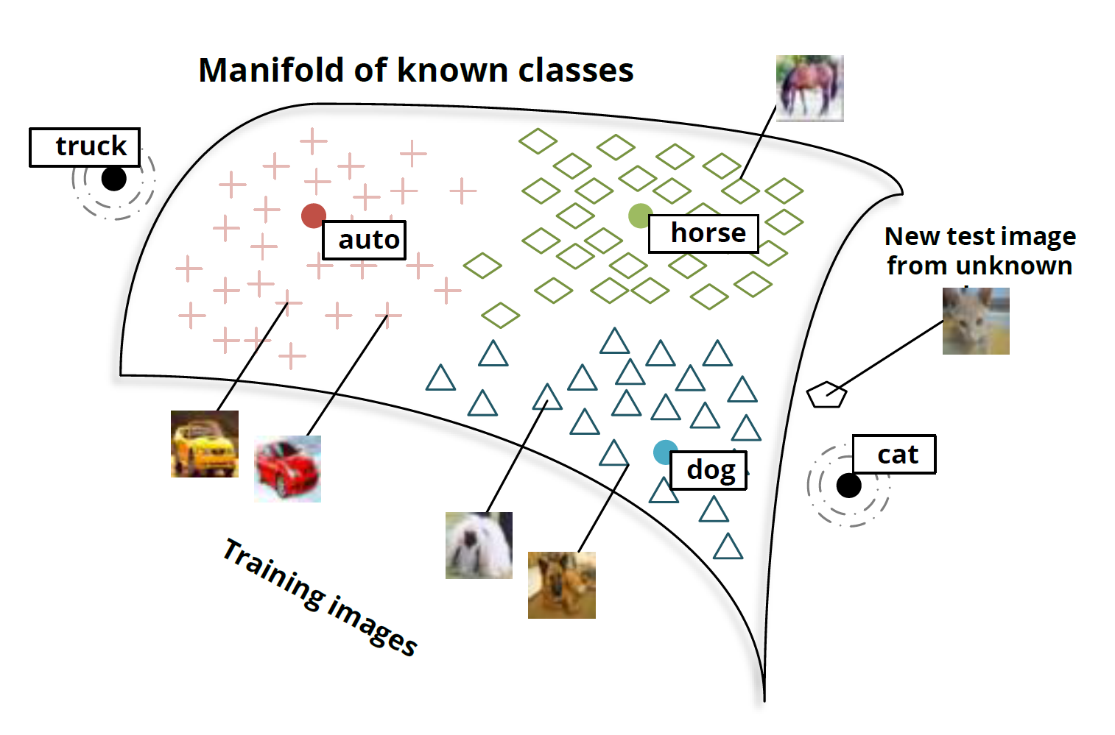
Another View: Manifolds and Classes

Slide 35
Ok, Great. What Then Is Learning?
Learning is a procedure that consists of estimating the model parameters so that the learned model (algorithm) can perform a specific task
In Artificial Neural Networks, these parameters are the weight matrix (w_{i,j}’s)
3+ types of learning considered here
Supervised Learning
Unsupervised Learning
Reinforcement Learning
Semi-supervised Learning
Supervised Learning
Present the algorithm with a set of inputs and their corresponding outputs
See how closely the actual outputs match the desired ones
Note generalization error (bias, variance)
Iteratively modify the parameters to better approximate the desired outputs (gradient descent)
Unsupervised Learning
Algorithm learns internal representations and important features
Reinforcement Learning
Learn from interacting with the environment (“trial and error”)
More on this later
So let’s take a closer look at these learning types

Slide 36
Supervised Learning
The desired response (function) of given inputs is well known
You are given the “answer” (label) in the training set
Training data is set of (x^{(i)},y^{(i)}) pairs, x^{(i)} is the input example, y^{(i)} is the label
Task is typically to predict the label y for new x (y = f(x))
There are many 10s (if not 100s or 1000s) of supervised learning learning algorithms
These include: Artificial Neural Networks, Decision Trees, Ensembles (Bagging, Boosting, Random Forests, …), k-NN, Linear Regression, Naive Bayes, Logistic Regression (and other CRFs), Support Vector Machines (and other Large Margin Classifiers), …
Focus on Artificial Neural Networks (ANNs) here
The Google Data Center PUE example we will look at later uses supervised learning on a deep neural network (if time)

Slide 37
Unsupervised Learning
Basic idea: Discover unknown structure in input data
Data clustering and dimension reduction
More generally: find the relationships/structure in the data set
No need for labeled data
The network itself finds the correlations in the data
Learning algorithms include (again, many algorithms)
K-Means Clustering
Auto-encoders/deep neural networks
Restricted Boltzmann Machines
Hopfield Networks
Sparse Encoders
…

Slide 38
Agenda
Who Am I?
Level Set: What Is Machine Learning?
What is all the (Machine Learning) Excitement About?
Integrated Approaches
Histograms, LDA, and Neural Networks
Machine Learning Excitement Redux: Beyond Static Learning
Technical explanations/code
https://github.com/davidmeyer/ml

Slide 39
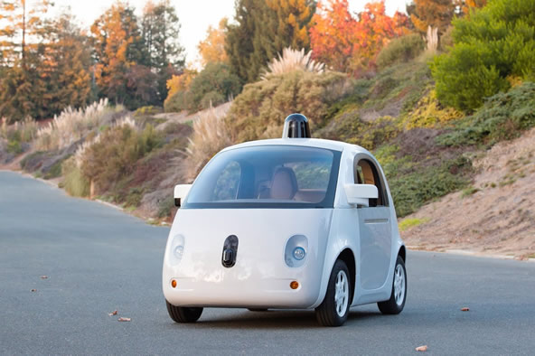
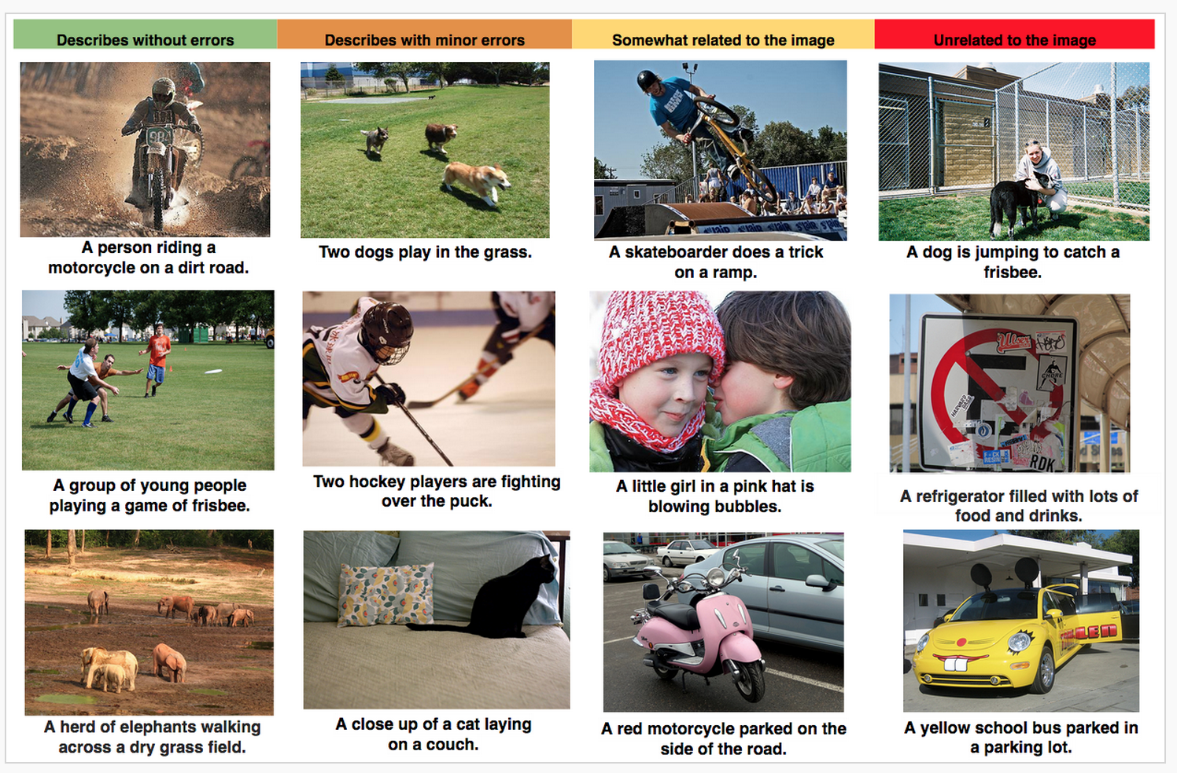

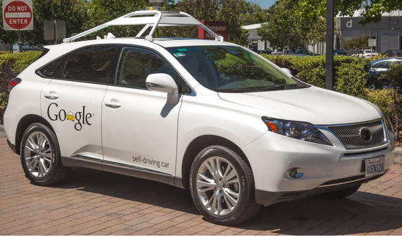
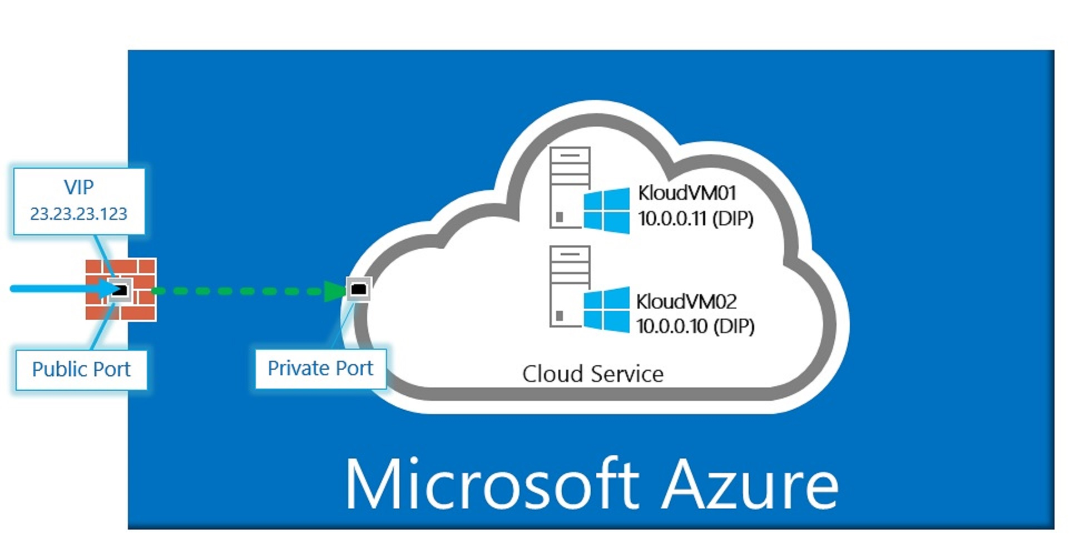


What is all the ML Excitement About? ML Applications You Likely Interact with Everyday
Why this is relevant: Compute, Storage, Networking, Security and Energy (CSNSE)
use cases will all use similar technology (deep nets, …)

Slide 40
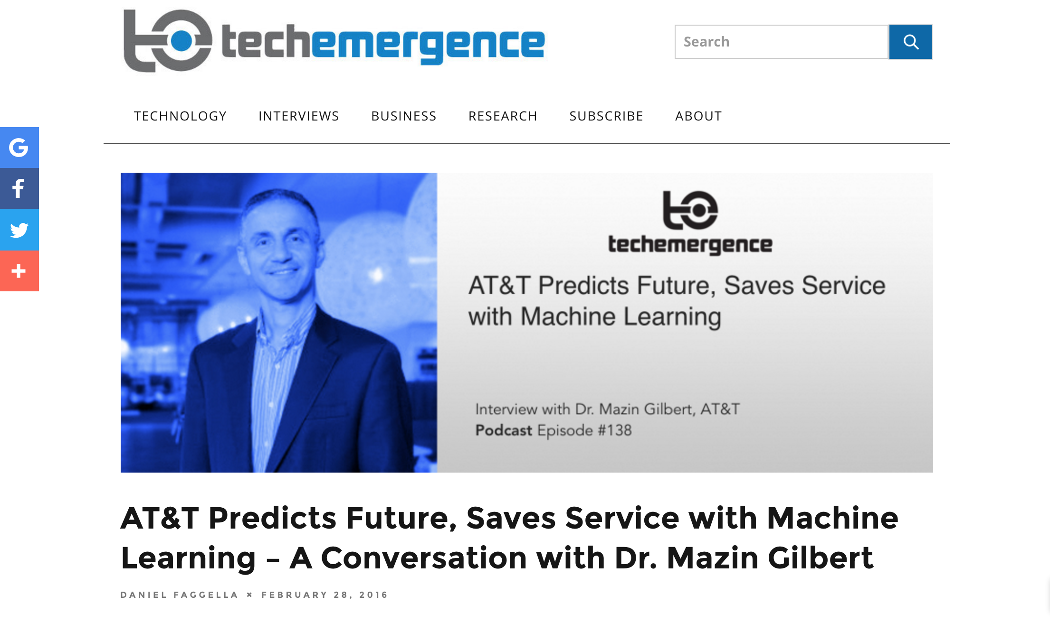
For example
“Machine learning is revolutionizing the world as we know it, both in and out of the
digital realms, and is predicted to expand to a $2 trillion market by 2025 (as reported by
Julie Bort in Business Insider).”

Slide 41

5G Networks

Slide 42

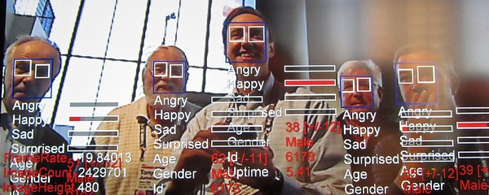
Think Object Recognition is Impressive?

Slide 43
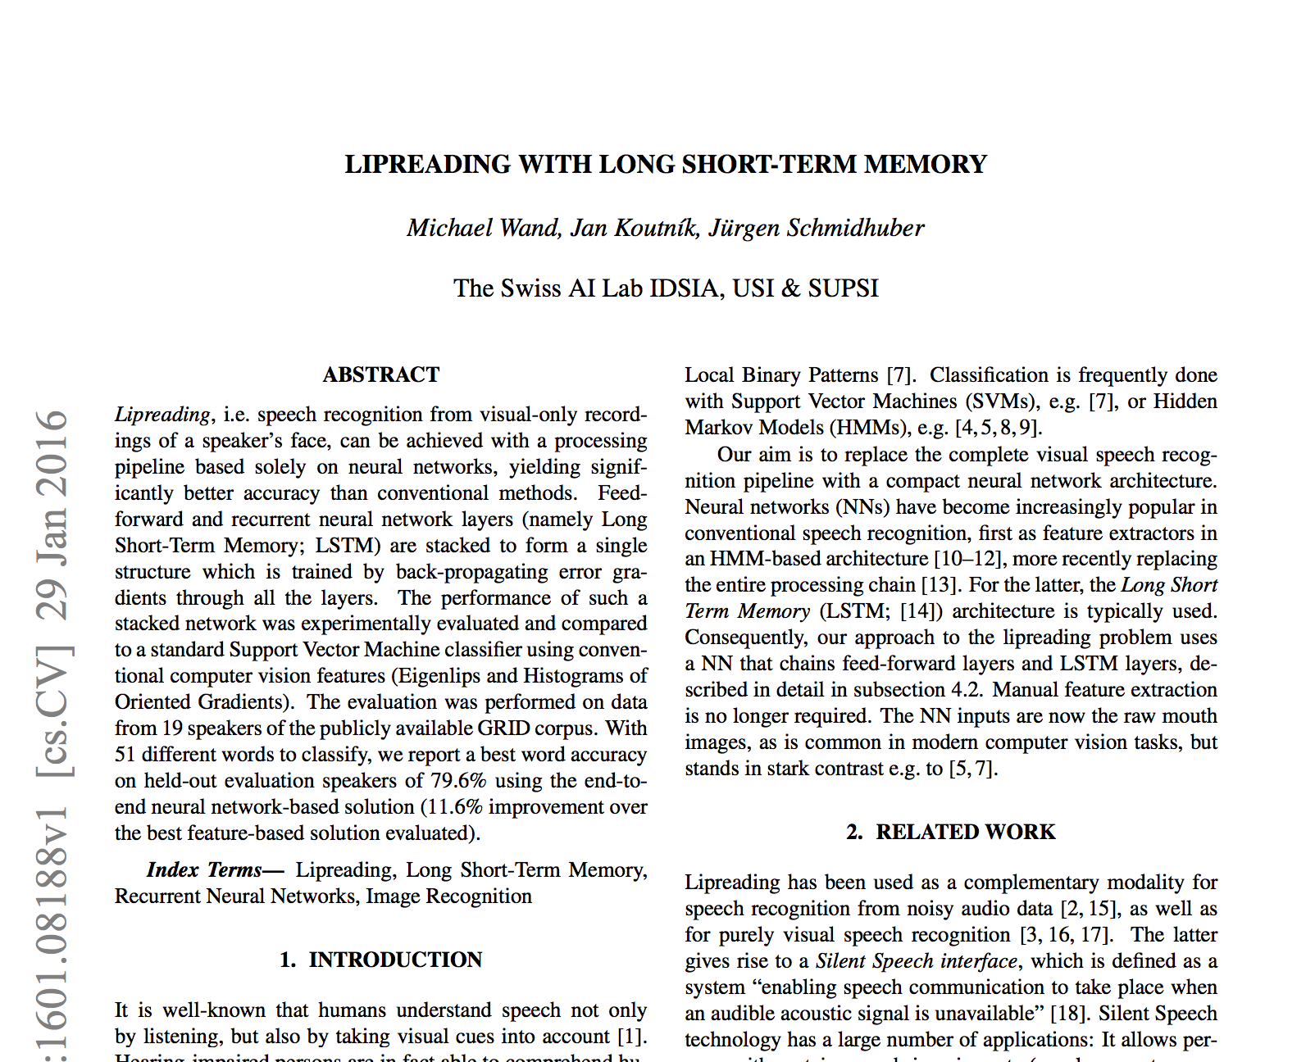
Lip Reading?

Slide 44
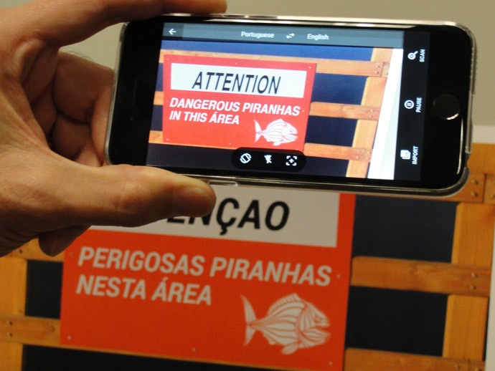
Real-Time Language Translation

Slide 45
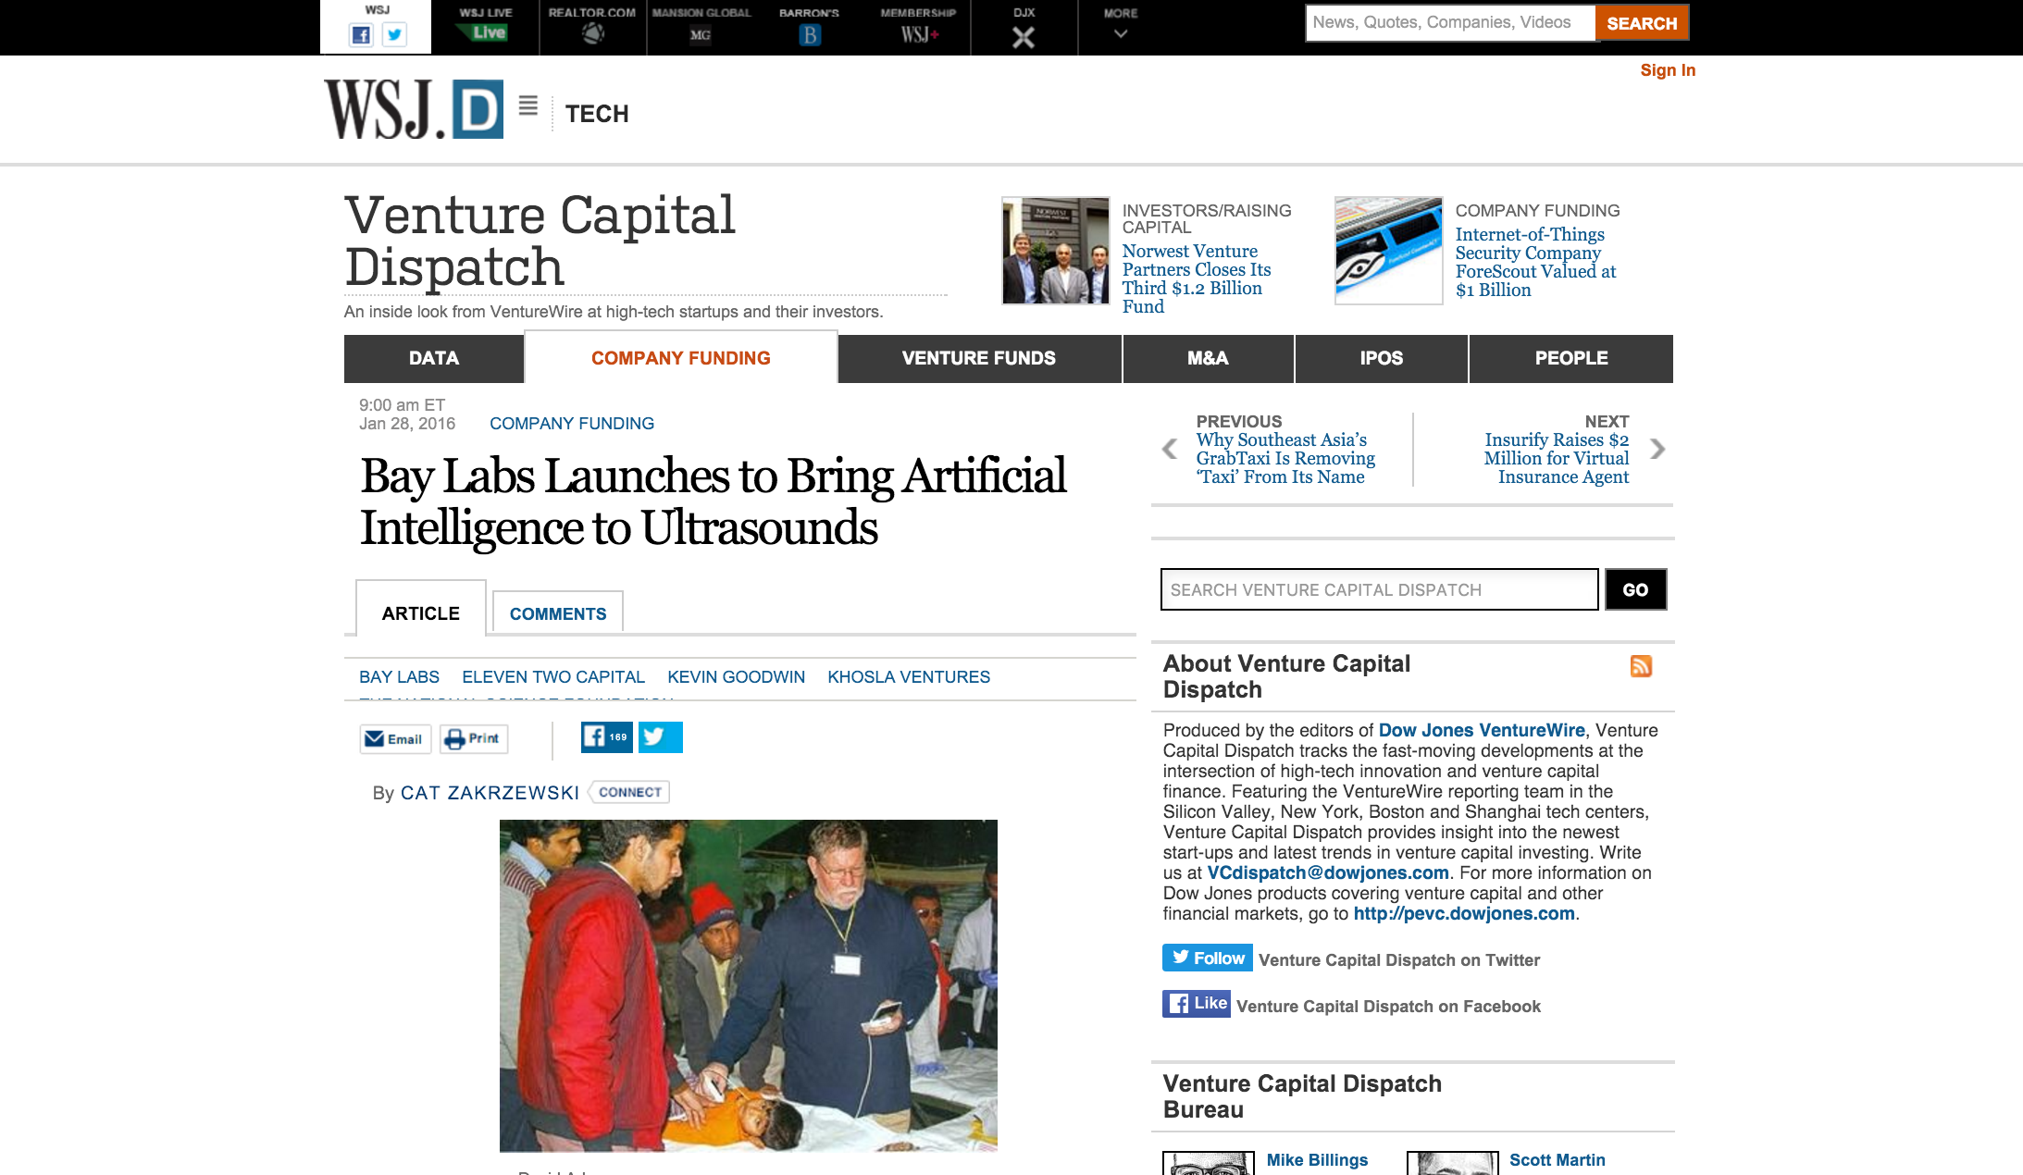
One More

Slide 46
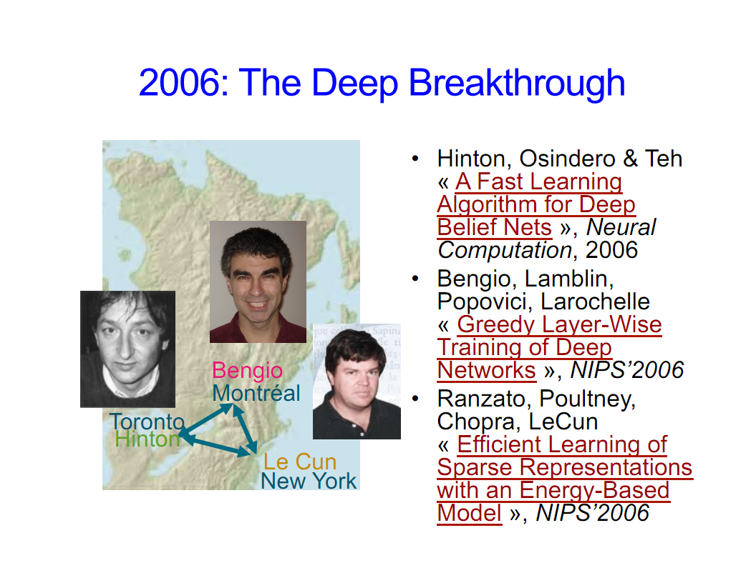
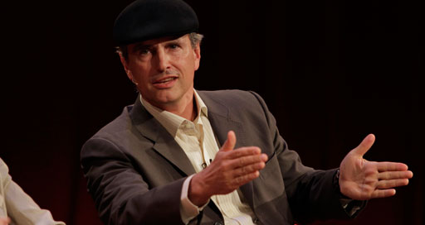
Why is this all happening now?
Before 2006 people thought deep neural networks couldn’t be trained
So why now?
Theoretical breakthroughs in 2006
Learned how to train deep neural networks
Technically: RBMs, Stacked Auto-encoders, sparse coding
Nice overview of LBH DL journey: http://chronicle.com/article/The-Believers/190147/
Compute
CPUs were 2^20s of times too slow
Parallel processing/algorithms
GPUs + OpenCL/CUDA
FPGAs, custom hardware
Datasets
Massive data sets: Google, FB, Baidu, …
Standardized data sets
Alternate view of history?
LBH Nature DL review: http://www.nature.com/nature/journal/v521/n7553/full/nature14539.html
Jürgen Schmidhuber’s critique : http://people.idsia.ch/~juergen/deep-learning-conspiracy.html
LBH rebuttal: http://recode.net/2015/07/15/ai-conspiracy-the-scientists-behind-deep-learning/
Image courtesy Yoshua Bengio

Slide 47
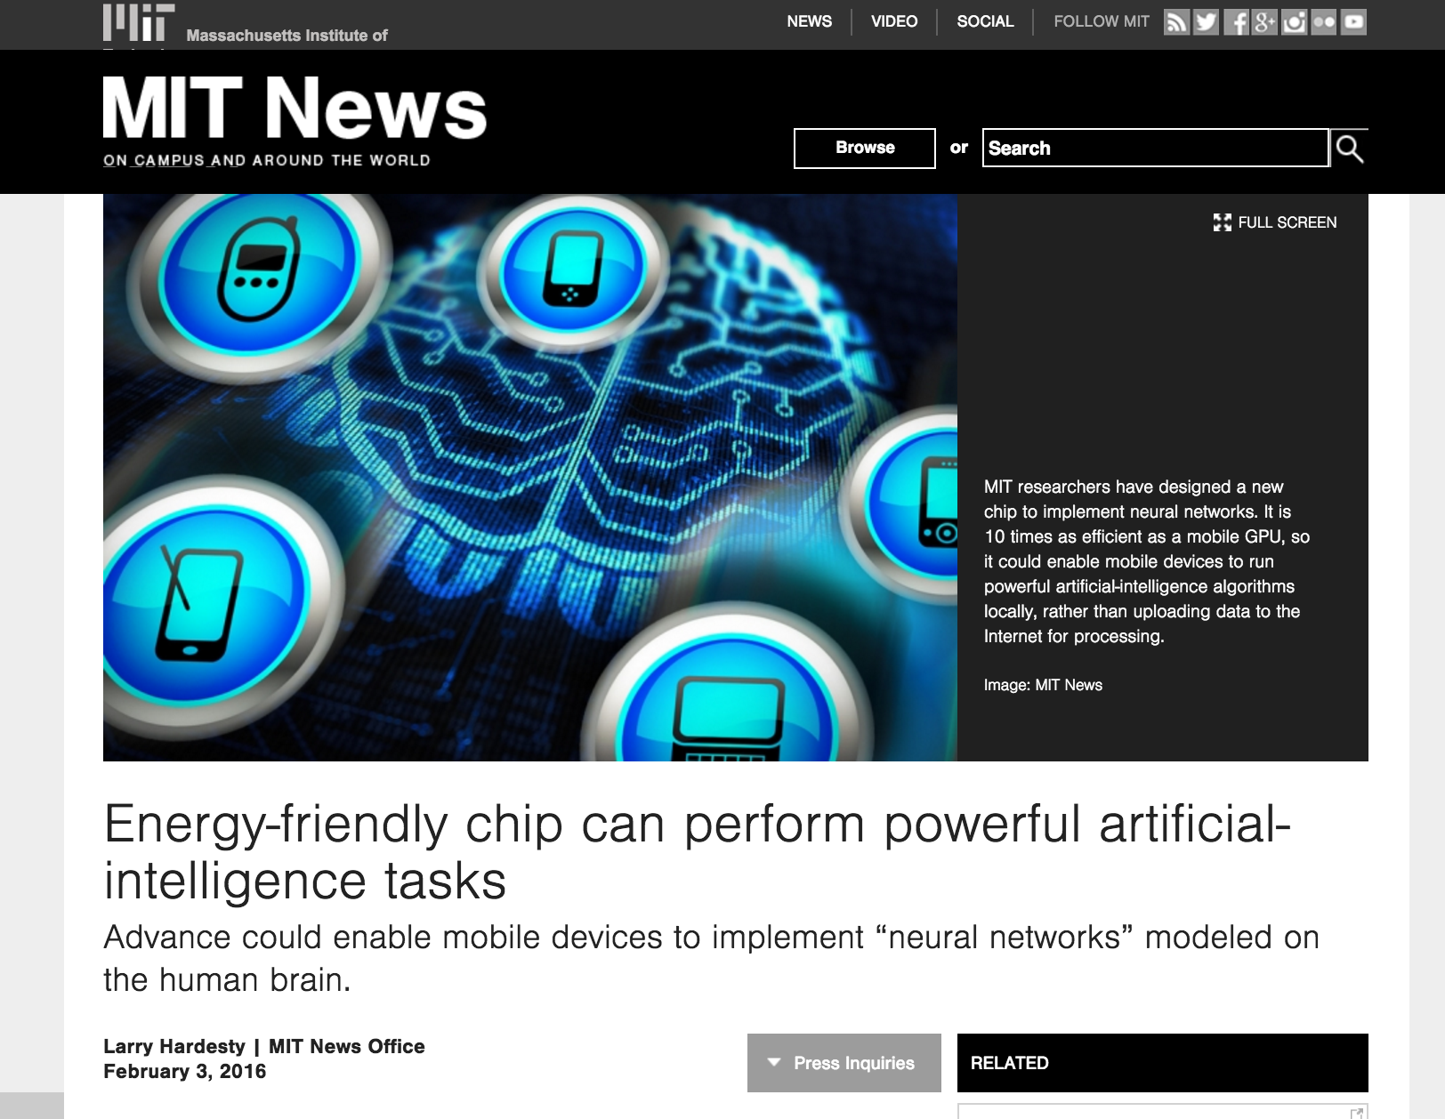
BTW, What Kinds of Custom H/W?

Slide 48
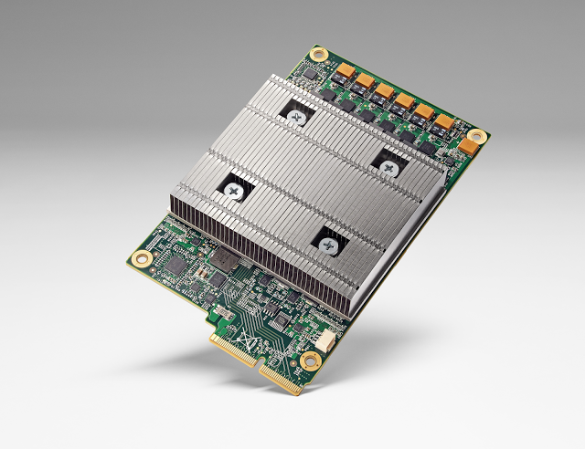
What Kinds of Custom H/W, cont Google TPU

Slide 49

What Kinds of Custom H/W, cont

Slide 50




Ok, We Know That Machines Are Getting Smarter, But Where Does Knowledge Come From?
Evolution
Experience
Many orders of magnitude
faster and larger
Culture
Machines
So how can machines
discover new knowledge?

Slide 51

How Can Machines Discover New Knowledge?
Fill the gaps in existing knowledge
Symbolists
Technology: Induction/Inverse Deduction
Emulate the brain
Connectionists
Technology: Deep neural nets
Emulate evolution
Evolutionaries
Technology: Genetic Algorithms
Systematically reduce uncertainty
Bayesians
Technology: Bayesian Inference
- Notice similarities between old and new
Analogizers
Technology: Kernel machines/Support Vector Machines
These correspond to the 5 major schools of thought in machine learning https://en.wikipedia.org/wiki/The_Master_Algorithm

Slide 52
Agenda
Who Am I?
Level Set: What Is Machine Learning?
What is all the (Machine Learning) Excitement About?
Integrated Approaches
Histograms, LDA, and Neural Networks
Machine Learning Excitement Redux: Beyond Static Learning
Technical explanations/code
https://github.com/davidmeyer/ml

Slide 53




Integrated Approaches Bringing Rigor to ML for Networking
Clustering
Categorical and continuous
e.g., Histograms, LDA, K-means, …
Most “Machine Learning” systems you see today
Anomaly detection
Deep Neural Networks
FF/Recurrent/memory nets (LSTMs, NTMs, ...)
Time series/long range dependencies
Understand sequences such as network flows
Can use autoencoders for anomaly detection too
Reinforcement Learning
Give Machine Learning agency
learn feedback control of actions
Non-stationary distributions
Deep neural networks (value/policy networks)
Understand/react in adversarial environments
Standardized (and public) data sets
Required to evaluate techniques
Move the field forward
e.g. MNIST , ImageNet, …

Slide 54

So What Kinds of Use Might We Work on With PSNC?
Security/Anomaly Detection
Site Reliability Engineering
NFV orchestration and optimization
New automation tools for DevOps
Predicting and remediating problems mobile networks
Network control plane optimization
Network Gamification
...
Importantly, we can use deep
neural networks to capture
intuition from experts in these
problem domains

Slide 55




BTW, Anomaly Detection: What and Why
It is clear that one of the major challenges we face as a civilization is dealing with deluge of data that are being collected from our networks at global (and beyond) scale
While at the same time we are “knowledge starved”
Can’t find the needles in an exponentially growing haystack
Anomaly Detection is one piece of the puzzle
Machine Learning is a fundamental part of the answer
Key Assumption for Anomaly Detection
Anomalous events occur relatively infrequently (alternatively: most events normal)
Second order assumption: Common events follow a Gaussian distribution (likely to be wrong)
What is obvious: When anomalous events do occur, their consequences can be quite serious and often have substantial negative impact on our businesses, security, …

Slide 56



So What are Anomalies?
An anomaly is a pattern that does not conform to the expected behaviour
How to define expected behaviour?
How to find the “outliers”?
Anomalies translate to significant real life events
Cyber intrusions
Cyber crime
Manufacturing/product defects
…
Linear Decision Boundary
Graphic courtesy Andrew Ng, others

Slide 57
Basic Idea Behind Anomaly Detection
An anomaly
Idea: Assume that a boundary exists and that - Nominal data is inside the boundary - Anomalous data is outside the boundary
Problem: How to estimate/approximate the boundary?
Problem: What measurement(s) caused the anomaly?
Collected ‘Nominal’ Data
Problem: How far off-nominal is the anomaly/feature?

Slide 58
Simple Example
N₁ and N₂ are regions of normal behaviour
Say, normal flows in a network
Points o₁ and o₂ are anomalies
Points in region O₃ are anomalies
Challenge:
How to define “normal” regions?
How to find the outlier points?
This is the job of machine learning
Y
N₁
o₁
O₃
o₂
N₂
X

Slide 59

Anomaly Detection Schemes
General Steps
Build a profile of the “normal” behavior
Profile can be patterns or summary statistics for the overall population
Use the “normal” profile to detect anomalies
Anomalies are observations whose characteristics differ significantly from the normal profile
Types of anomaly detection schemes
Graphical & Statistical-based
Distance-based
Model-based
FP Mining, K-means, …

Slide 60
3 Main Types of Anomaly
Point Anomalies
Contextual Anomalies
Collective Anomalies

Slide 61
Point Anomalies
An individual data instance is anomalous if it deviates significantly from the rest of the data set.
Y
Anomaly
N₁
o₁
O₃
o₂
N₂
X

Slide 62
Contextual Anomalies
Individual data instance is anomalous within a context
Requires a notion of context
Also referred to as conditional anomalies
Anomaly
Normal

Slide 63
Collective Anomalies
A collection of related data instances is anomalous
Requires a relationship among data instances
Sequential Data
Spatial Data
Graph Data
The individual instances within a collective anomaly are not anomalous by themselves
Anomalous Subsequence
Anomalous Subsequence

Slide 64
Key Challenges for Anomaly Detection Algorithms
Defining a representative normal region is challenging
The boundary between normal and outlying behaviour is often not precise
The exact notion of an outlier is different for different application domains
Availability of labelled data for training/validation (unsupervised learning)
Malicious adversaries
Data is very noisy
False positive/negatives
Normal behaviour keeps evolving (non-stationary distributions)

Slide 65
Machine Learning Approaches
Time-Based Inductive Methods
Use probability and a directed graph to predict the next event
Bayesian approaches
Can also use undirected approaches (Markov Random Fields)
Instance Based Learning
Define a distance to measure the similarity between feature vectors
Histograms, K-Means, …
Neural Networks
Autoencoders: hyper-parameter bounds reconstruction error
…

Slide 66

Example: Using Flow Data for Anomaly Detection
Generalized Anomaly Detection Setting
Linear Decision Boundary
Generalization Graph Radial Nested Block State Model with Edge Bundling
DNS tunneling

Slide 67

Another Visualization (same data)
Linear Decision Boundary

Slide 68


What is Really Happening Here?
Linear Decision Boundary
Target function represented by input data is some twisted up manifold
Deep Nets disentangle the underlying explanatory factors in the data so as to make them linearly separable
Graphic courtesy Christopher Olah
Voronoi diagram under Euclidian distance
Voronoi diagram under Euclidian distance
Linear Separability in a Neural Network
Linear Separability in a Neural Network

Slide 69
Agenda
Who Am I?
Level Set: What Is Machine Learning?
What is all the (Machine Learning) Excitement About?
Integrated Approaches
Histograms, LDA, and Neural Networks
Machine Learning Excitement Redux: Beyond Static Learning
Technical explanations/code
https://github.com/davidmeyer/ml

Slide 70

Histograms
Essentially unnormalized counts (normalizing a histogram → probability distribution)
Works with categorical data (again, counts)
Design metric to reflect the distance between “histograms” (vectors)
Popular: Mahalanobis Distance (https://en.wikipedia.org/wiki/Mahalanobis_distance)
http://scikit-learn.org/stable/modules/generated/sklearn.neighbors.DistanceMetric.html

Slide 71
Overview: Latent Dirichlet Allocation (LDA)
Proposed as a form of Topic Modeling
Canonical reference
http://www.jmlr.org/papers/volume3/blei03a/blei03a.pdf
Open Network Insight
https://github.com/Open-Network-Insight
Lets take a deeper dive

Slide 72

Sub-agenda: Topic Modeling and LDA
What is Topic Modeling?
Parametric vs. Non-Parametric Models
Latent Dirichlet Allocation
Probabilistic Graphical Models
The Effect of the Dirichlet parameter $α$
Dynamic LDA

Slide 73

Topic Modeling
Methods for automatically organizing, understanding, searching and summarizing categorical data
Goals
Uncover hidden topical patterns
Annotate documents according to topics
Organize, Summarize, Search

Slide 74

A Bit of Information Retrieval (IR) Terminology
Corpus: is a large and structured set of texts
Stop words: words which are filtered out before or after processing of natural language data (text)
Unstructured text: information that either does not have a pre-defined data model or is not organized in a pre-defined manner.
Tokenizing: process of breaking a stream of text up into words, phrases, symbols, or other meaningful elements called tokens (see also lexical analysis)
Natural language processing: field of computer science, artificial intelligence, and linguistics concerned with the interactions between computers and human (natural) languages
Term document (or document term) matrix: is a mathematical matrix that describes the frequency of terms that occur in a collection of documents
Supervised learning: s the machine learning task of inferring a function from labeled training data
Unsupervised learning: find hidden structure in unlabeled data
Stemming: the process for reducing inflected (or sometimes derived) words to their word stem, base or root form—generally a written word form
Graphic courtesy Wikipedia

Slide 75

IR Workflow
Graphic courtesy http://www.jisc.ac.uk/reports/value-and-benefits-of-text-mining

Slide 76

Agenda
What is Topic Modeling?
Parametric vs. Non-Parametric Models
Latent Dirichlet Allocation
Probabilistic Graphical Models
The Effect of the Dirichlet parameter $α$
Dynamic LDA

Slide 77

Parametric vs. Non-parametric Models
Parametric models assume some finite set of parameters $θ.$ This means that given parameters $θ,$future predictions x are independent of the data D. That is:
p(x|$θ, D)=$p(x|$θ)$
This implies that $θ$ captures everything there is to know about the data
Also means that the complexity of the model is bounded even if the amount of data isn’t
Taken together these factors make parametric models inflexible
Information theoretic view
Information is constrained to flow from the prior through finite $θ$to the posterior
Remembering that the $posterior=\frac{likelihood ∙ prior }{evidence}$
$p\left(θ | x\right)= \frac{p\left(x | θ\right) ∙ p(θ)}{p(x)}= \frac{p(x,θ)}{p(x)} = \frac{p\left(x,θ\right)}{\int{p\left(x,θ\right)dθ}}$
http://www.1-4-5.net/~dmm/ml/ps.pdf
Latent Dirichlet Allocation is a parametric model (why?)

Slide 78

Non-Parametric Models
Non-parametric models assume that the data distribution cannot be defined in terms of such a finite set of parameters
Parameters can often be described using an infinite dimensional $θ$
Think of $θ as$a function
The amount of information that $θ$ can capture about the data D can grow as the amount of data grows
This makes non-parametric models more flexible
Better predictive performance
More “realistic”
Most successful ML models are non-parametric
Examples include
Kernel methods (SVMs, GPs)
DNNs
K-NNs, …

Slide 79

Agenda
What is Topic Modeling?
Parametric vs. Non-Parametric Models
Latent Dirichlet Allocation
Probabilistic Graphical Models
The Effect of the Dirichlet parameter $α$
Dynamic LDA
Q&A

Slide 80
Latent Dirichlet Allocation (LDA)
Generative probabilistic model
Parametric Bayesian Probabilistic Graphical Model
Treats data as observations
Contains hidden variables
Hidden variables reflect thematic structure of the collection
Wealth of material here:
https://www.cs.princeton.edu/~blei/topicmodeling.html
Approach: Infer hidden structure using posterior inference
Discovering topics in the collection using Bayesian inference
Placing new data into the estimated model
Situating new documents into the estimated topic structure
Other Approaches
Latent Semantic Indexing (LSI)
Probabilistic Latent Semantic Indexing (pLSI)
…

Slide 81

LDA Basic Intuition http://ai.stanford.edu/~ang/papers/nips01-lda.pdf
Obvious Questions
What exactly is a topic?
Where do topics come from?
How many “topics”/document
Simple Intuition:
Documents exhibit multiple topics
Contrast “mixture” models
Graphic courtesy David Blei https://www.cs.princeton.edu/~blei/kdd-tutorial.pdf
Notes:
Simple Intuition: Documents exhibit multiple topics

Slide 82

LDA Generative Model Hallucinate that the observed data were generated this way
Assume topics exists outside of the document collection
Each topic is a distribution over fixed vocabulary
Each word is drawn from one of those topics
Each document is a random mixture of corpus-wide topics
Graphic courtesy David Blei https://www.cs.princeton.edu/~blei/kdd-tutorial.pdf
Notes:
Every topic is a distribution over a fixed vocabulary.
Every document is a random mixture of corpus-wide topics.
Choose a distribution over topics.
For each word, draw a colored coin from this distribution.
Look up the distribution of terms associated with that coin.
Draw that word from that distribution.
This process is repeated for every document.

Slide 83

BTW, What Do We Actually Observe?
So our goal here is to infer the hidden (latent) variables
i.e., compute their distribution conditioned on the documents:
p(topics, proportions, assignments | documents)
Graphic courtesy David Blei https://www.cs.princeton.edu/~blei/kdd-tutorial.pdf

Slide 84


β_{1:K}
Let K be the number of topics (distributions over words) # β_{1:K} ~ Dir(η)
For each document d in corpus C:
Draw the topic proportion distribution θ_{d} for document d # θ_{d} ~ Dir(α)
For each n = 1..N_{d}: # N_{d} = # words in d
Draw topic index z_{d,n} for the n^{th} word of d from θ_{d} # 1 $≤$ z_{d,n} $≤$K
Draw word w_{d,n} from topic β[z_{d,n}] # z_{d,n} indexes β_{1:K}

Slide 85

Agenda
What is Topic Modeling?
Parametric vs. Non-Parametric Models
Latent Dirichlet Allocation
Probabilistic Graphical Models
The Effect of the Dirichlet parameter $α$
Dynamic LDA
Q&A

Slide 86

Probabilistic Graphical Models
Graphic courtesy https://www.cs.princeton.edu/~blei/kdd-tutorial.pdf

Slide 87

Probabilistic Graphical Models, Cont
Graphic courtesy https://www.cs.princeton.edu/~blei/kdd-tutorial.pdf

Slide 88

LDA Graphical Model (based on the generative model)
Graphic courtesy https://www.cs.princeton.edu/~blei/kdd-tutorial.pdf

Slide 89

LDA Graphical Model Details

Slide 90

What is the LDA Joint Distribution?

Slide 91
Why does w_{d,n} depend on z_{d,n} and β?
V x K Topic Matrix
Columns are the β_{k}s
K
Z_{d,n}
K -- number of topics
V -- number of words in the vocabulary
TM_{VxK} -- topic matrix
Z_{d,n} -- index of topic which W_{d,n} comes from
W_{d,n} -- the n^{th} word in the d^{th} document
TM[W_{d,n,}Z_{d,n}] -- the probability of W_{d,n}, β_{k}[w_{d,n}] (k = z_{d,n})
W_{d,n}
V
1
1
1
1
…….
1

Slide 92

Now, What Exactly is the Dirichlet Distribution
(and why are we using it?)
The Dirichlet is a “dice factory”
Multivariate equivalent of the Beta distribution (“coin factory”)
Parameters α determine the form of the prior
The Dirichlet is defined over the (k-1) simplex
The k non-negative arguments which sum to one
The Dirichlet is the conjugate prior to the multinomial distribution
If the likelihood has conjugate prior P then the posterior has the same form as P
If we have a conjugate prior we know the (closed) form of the posterior
So in this case the posterior is also a Dirichlet
The parameter α controls the mean shape and sparsity of θ
In LDA the topics are a V-dimensional Dirichlet and the topic proportions are a K-dimensional Dirichlet

Slide 93

Simplex? (space of non-negative vectors which sum to one)

Slide 94


Aside: Conjugate Priors
Notes/Issues:
Conjugate Prior: If the likelihood has conjugate prior P then the posterior has the same form as P
The conjugate prior might not correctly reflect our uncertainty about $θ$
Non-conjugate priors are typically not available in analytic (closed) form
It is difficult to quantify our uncertainty about $θ$ in the form of a particular distribution

Slide 95

Agenda
What is Topic Modeling?
Parametric vs. Non-Parametric Models
Latent Dirichlet Allocation
Probabilistic Graphical Models
The Effect of the Dirichlet parameter $α$
Dynamic LDA

Slide 96


The Effect of the Dirichlet parameter $α$
Generalizing the Idea of Co-Occurrence

Slide 97

α = 1
Graphic courtesy https://www.cs.princeton.edu/~blei/kdd-tutorial.pdf

Slide 98

α = 0.1

Slide 99

α = 0.001
Essentially a mixture model (one topic/document)

Slide 100

α = 10

Slide 101

α = 100
Larger α spreads out the mass

Slide 102

Ok, but we need the Posterior
So we need to use approximate inference

Slide 103

Approximate Inference

Slide 104

Variational Inference

Slide 105


Jensen’s Inequality
Jensen's inequality generalizes the observation that the secant line of a convex function lies above the graph of the function
In probability theory Jensen’s Inequality is generally stated in the following form: If X is a random variable and $φ$is a convex function, then $φ$(E[X]) $≤$E[$φ$(X)]

Slide 106

Jensen’s Inequality, Bounds, and KL Divergence

Slide 107


KL-Divergence

Slide 108

Why Does LDA Work?

Slide 109

Why Does LDA Work?

Slide 110

LDA Summary

Slide 111

Agenda
What is Topic Modeling?
Parametric vs. Non-Parametric Models
Latent Dirichlet Allocation
Probabilistic Graphical Models
The Effect of the Dirichlet parameter $α$
Dynamic LDA

Slide 112

Beyond LDA: Dynamic Topic Models
Graphic courtesy https://www.cs.princeton.edu/~blei/kdd-tutorial.pdf

Slide 113

So What are Our Words, Documents, …
Documents: Source/Dest IP address pairs
Words: ports, TCP flags, …

Slide 114

What Kinds Of Questions Can We Ask?

Slide 115
Artificial Neural Networks
A Bit of History
Biological Inspiration
Artificial Neurons (AN)
Artificial Neural Networks (ANN)
Computational Power of Single AN
Computational Power of an ANN
Training an ANN -- Learning

Slide 116
Brief History of Neural Networks
1943: McCulloch & Pitts show that neurons can be combined to construct a Turing machine (using ANDs, ORs, & NOTs)
1958: Rosenblatt shows that perceptrons will converge if what they are trying to learn can be represented
1969: Minsky & Papert showed the limitations of perceptrons, killing research for a decade
1985: The backpropagation algorithm revitalizes the field
Geoff Hinton et al
2006: The Hinton lab solves the training problem for DNNs

Slide 117
Biological Inspiration: Neurons
A neuron has
Branching input (dendrites)
Branching output (the axon)
Information moves from the dendrites to the axon via the cell body
Axon connects to dendrites via synapses
Synapses vary in strength
Synapses may be excitatory or inhibitory

Slide 118

Basic Perceptron (Rosenblatt, 1950s and early 60s)
What was the problem
here?

Slide 119

What is an Artificial Neuron?
An Artificial Neuron (AN) is a non-linear parameterized function with restricted output range
y
b
w₁
w₂
w₃
x1
x2
x3
Lets blow this up a bit
Spike-Timing Dependent Plasticity (STDP)
http://en.wikipedia.org/wiki/Hebbian_theory

Slide 120


Mapping to Biological Neurons
Dendrite
Cell Body
Axon

Slide 121

Activation Functions – Linear Function

Slide 122

Activation Functions – Hyperbolic Tangent

Slide 123


Activation Functions – Sigmoid Function
Recent successes (e.g., Baidu Deep Speech) use
(clipped) Rectifier Linear Units:
f(x) = max(0,x) -- rectifier
f(x) = min(max(0,x), clip)
Smooth approximation (softplus):
Squashes the input (x) onto the open interval [0,1]

Slide 124
Summary: Artificial neurons
An Artificial Neuron is a non-linear parameterized function with restricted output range
y
w0
w₀ also called a bias term (b_{i})
x1
x2
x3

Slide 125
Ok, Then What is an Artificial Neural Network (ANN)?
An ANN is mathematical model designed to solve engineering problems
Group of highly connected artificial neurons to realize compositions of non-linear functions (usually one of the ones we just looked at)
Tasks
Classification
Discrimination
Estimation
2 main types of networks
Feed forward Neural Networks
Recurrent Neural Networks

Slide 126
Feed Forward Neural Networks
The information is propagated from the inputs to the outputs
Directed Acyclic Graph (DAG)
Computes one or more non-linear functions
Computation is carried out by composition of some number of algebraic functions implemented by the connections, weights and biases of the hidden and output layers
Hidden layers compute intermediate representations
Dimension reduction
Time has no role -- no cycles between outputs and inputs
Output layer
2nd hidden
layer
1st hidden
layer
x₁
x₂
…..
x_{n}
We say that the input data, or features, are n dimensional

Slide 127





Deep Feed Forward Neural Nets (in 1 Slide (☺))
(x^{(i)},y^{(i)})
h_{θ}(x^{(i)})
Where do the weights come from?
hypothesis
Forward Propagation
So what then is learning?
Learning is the adjusting of the weights w_{i,j} such that
the cost function J(θ) is minimized (a form of Hebbian
learning).
Simple learning procedure: Back Propagation (of the error signal)

Slide 128

Forward Propagation Cartoon

Slide 129





Back propagation Cartoon
http://chronicle.com/article/The-Believers/190147

Slide 130

More Formally Empirical Risk Minimization
(loss function also called “cost function” denoted J(θ))
Any interesting cost function is complicated and non-convex

Slide 131

Solving the Risk (Cost) Minimization Problem Gradient Descent – Basic Idea

Slide 132

Gradient Descent Intuition 1 Convex Cost Function
One of the many nice properties of
convexity is that any local minimum
is also a global minimum

Slide 133

Gradient Decent Intuition 2
Can get stuck here if unlucky/start
at the wrong place
Unfortunately, any interesting cost function is likely non-convex

Slide 134

Solving the Optimization Problem Gradient Descent for Linear Regression
The big breakthrough came from the Hinton lab at UToronto in the mid 80’s where
the back propagation algorithm was discovered (or perhaps re-discovered). “Backprop”
is a simple way of computing the gradient of the loss function with respect to the model
parameters θ

Slide 135

Summary: Supervised Learning Process

Slide 136
Making this Real (what do we have to do?)
Choose the labels of interest
What are the classes of interest, what might we want to classify/compute/predict?
Get the data sets (this is always the “trick”)
Labeling?
Split into training, test, cross-validation
Avoid generalization error (bias, variance)
Avoid data leakage
Choose a model
I would try supervised DNN
Extremely powerful model
We want to find “non-obvious” features, which likely live in high-dimensional space
Write code
Then write more code
Test on (previously) unseen examples
Iterate

Slide 137
Issues/Challenges
Is there a unique model that we can use?
Unlikely → online learning
Ensemble learning, among others
Network data is non-perceptual (we think)
Does the Manifold Hypothesis hold for non-perceptual data sets?
Seems to (Google PUE, etc)
Unlabeled vs. Labeled Data
Most commercial successes in ML have come with deep supervised learning → labeled data
We don’t have ready access to large labeled data sets (always a problem)
Time Series Data
With the exception of Recurrent Neural Networks, most ANNs do not explicitly model time (e.g., Deep Neural Networks)
Flow data/sampling
Training vs. {prediction,classification} Complexity
Stochastic (online) vs. Batch vs. Mini-batch
Where are the computational bottlenecks, and how do those interact with (quasi) real time requirements?

Slide 138
Agenda
Who Am I?
Level Set: What Is Machine Learning?
What is all the (Machine Learning) Excitement About?
Integrated Approaches
Histograms, LDA, and Neural Networks
Machine Learning Excitement Redux: Beyond Static Learning
Technical explanations/code
https://github.com/davidmeyer/ml

Slide 139

What is All the Excitement About, Redux
Reinforcement learning meets Deep Learning and Monte Carlo Tree Search

Slide 140

TPUs AlphaGo Used To Beat Lee Sedol

Slide 141



One of the many ”AlphaGo Breakthroughs”
http://www.1-4-5.net/~dmm/ml/log_derivative_trick.pdf

Slide 142

Training the SL Policy Network
Deep Convolution Neural Network Captures the Intuition of Expert Go Players
Do we have a source of expert knowledge
that can be used for supervised learning in
a network setting?

Slide 143


BTW, Why Is Go So Hard?
Game Tree Complexity = b^{d}
Brute Force Search Intractable
Search space is huge (10^721)
Difficult to evaluate who is winning
Can we characterize network state and action spaces?
And why is this important?

Slide 144







Typical Workflow Schematic
Domain Knowledge
Domain Knowledge
Domain Knowledge
Domain Knowledge
Importantly, control is not learned
Analytics Platform
Learning
Presentation Layer
Intelligence
Data Collection
Packet brokers, flow data, …
Preprocessing
Big Data, Hadoop, Data Science, …
Learning
Inference
Remediation/Optimization/…
Business
Logic
Intent
Topology, Anomaly Detection,
Root Cause Analysis,
Predictive Insight, ….

Slide 145


Static vs. Reinforcement Learning Architectures
Today’s Static ML Architectures
ML doesn’t have “agency”
Hard-coded or open loop control
Doesn’t learn control
Assumes stationary DGD
Largely off-line
Reinforcement Learning Architecture
Agent architecture
Agent learns control/action selection
Adapts to evolving environment
Non-stationary distributions
Network gamification

Slide 146
Network Gamification?
Gamification is the application of game theoretic approaches and design techniques to what have traditionally been non-game problems, including business, operations and social impact challenges
Online learning/optimization
Security
Automation
Almost any application that interacts with its environment
Idea: Envision network and other automation tasks as 2-player games, and use Deep Learning, Reinforcement Learning and Monte Carlo Tree Search to learn optimal control in an online setting

Slide 147

Summary: Why Is AlphaGo Important/Relevant?
Security: Agent can learn dynamic/evolving behavior of adversary
DevOPs: Agent can learn workflow automation (e.g. Openstack Mistral/StackStorm)
Orchestration: Agent can learn dynamic behavior of VNFs and system as a whole
General: Deep learning can capture human intuition

Slide 148



Example: Gamifying Workflows
Workflows can be learned/optimized
Model as a POMDP: <S,A,T,R,$Ω$,O,𝛾>
Estimate with MDP: <S,A,T,R,𝛾>
Model free
Deep Value (Q) and Policy ($π)$ networks
Boolean state test/actions
State Transitions
$$π\left(s\right)=a$$
$$s ∈S, a ∈A(s)$$
https://github.com/StackStorm
https://gym.openai.com/
https://github.com/StackStorm/st2/blob/master/contrib/examples/actions/chains/echochain.yaml

Slide 149

Interested in Reinforcement Learning?

Slide 150

One of the Many Important Things OpenAI is Doing

Slide 151
Agenda
Who Am I?
Level Set: What Is Machine Learning?
What is all the (Machine Learning) Excitement About?
Integrated Approaches
Neural Networks
Machine Learning Excitement Redux: Beyond Static Learning
Technical explanations/code
https://github.com/davidmeyer/ml
http://www.1-4-5.net/~dmm/ml

Slide 152
Q&A
Thank you

